Slide 1
WELCOME
ENJOY SOME FOOD
THANK YOU’S
SEASON RECAP
LOOKING AHEAD
HONORING THE ATHLETES

Slide 2
SUMMER RUNNING
2018 2019
22:46 19:14 Caroline Reich
16:07 14:32 Chole Wolk
23:17 20:30 Alex Tiatia
20:26 19:56 Nicole Dobrin

Slide 3
SUMMER OPPORTUNITIES
Summer Running: Mon – Th 6:30 AM
GLXC
University Running Camps
Make a Goal
Sign up for a race!

Slide 4
IHSA STATE CHAMPIONSHIP
Nov 7, 2020
2020 VISION

Slide 5
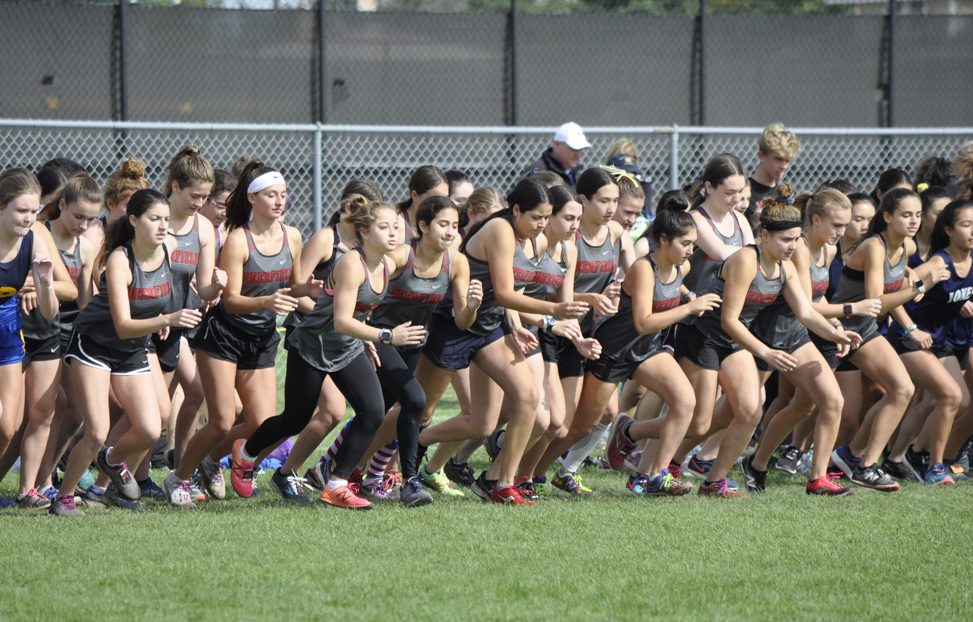
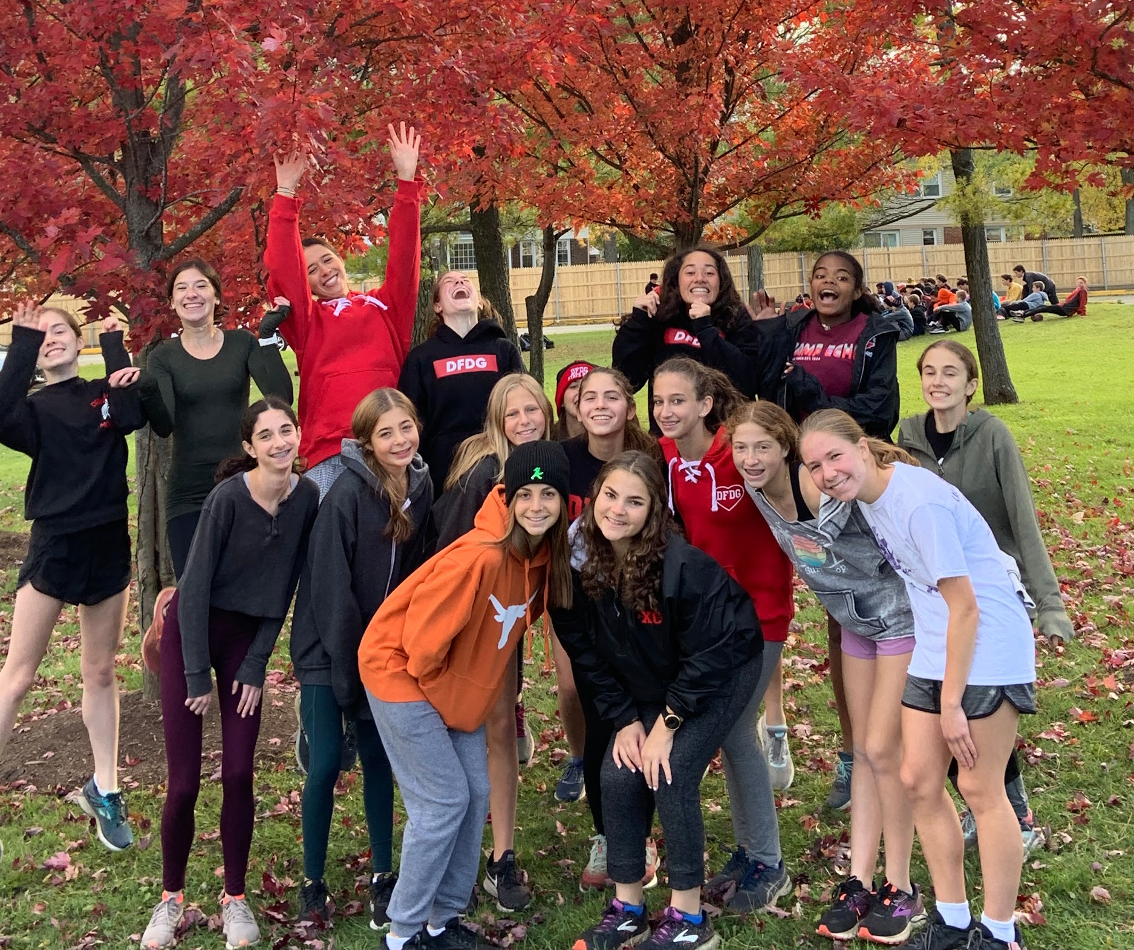
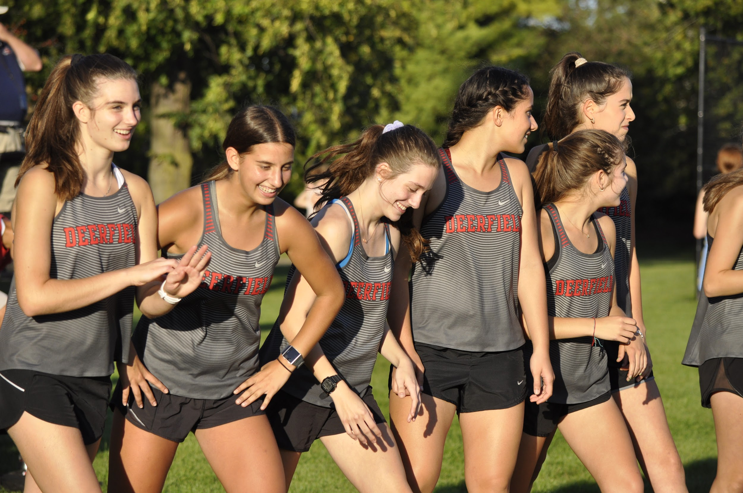
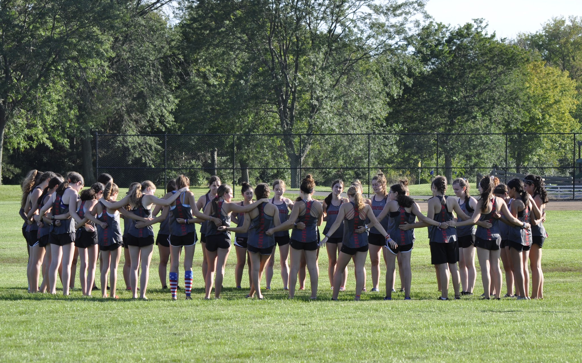
GIRLS CROSS COUNTRY 2019

Slide 6
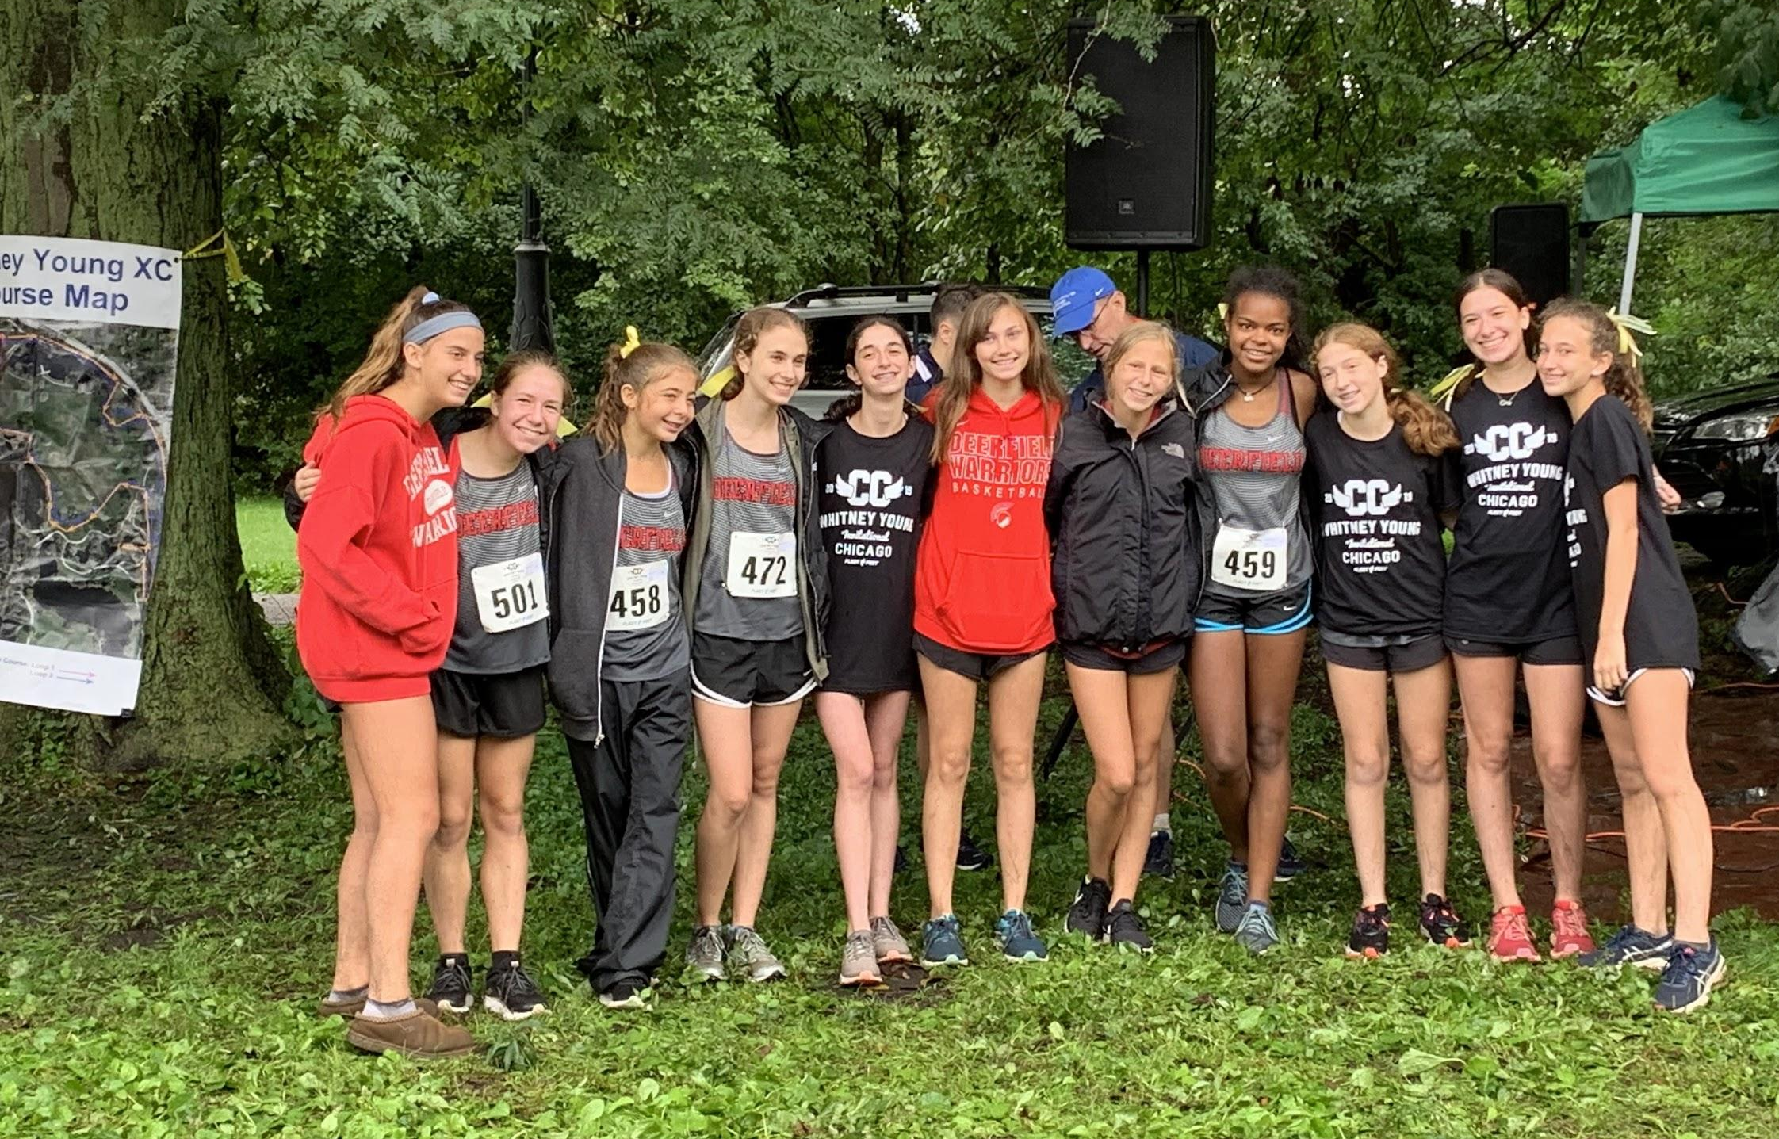
FRESHMEN

Slide 7
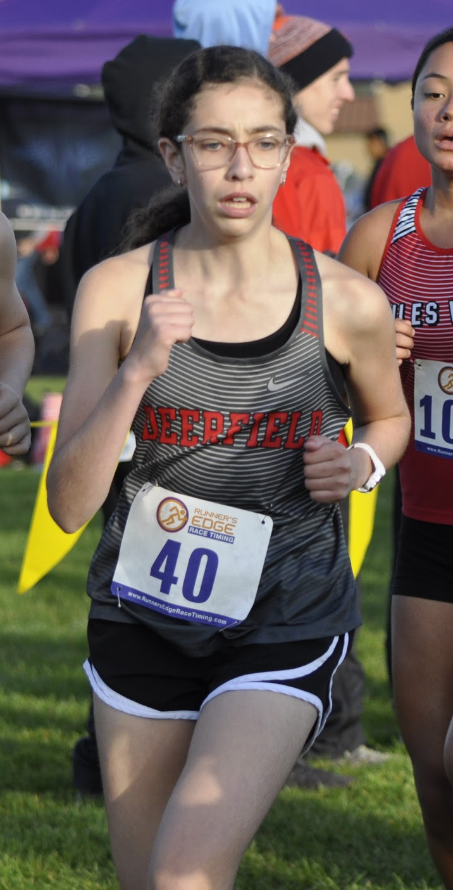
Hanna Otero
Meet | Date | Dist. | Finish Time | PPM
Home vs. ZB, Warren, Mather | 8/29 | 2 | 21:08 | 10:34
Lake Park Invite | 9/14 | 2 | 19:42 | 9:51
Main West Quad | 9/17 | 2 | 23:27 | 11:44
Peoria/Libertyville | 9/21 | 3 | 33:51 | 11:17
VH Quad | 9/24 | 2 | 21:40 | 10:40
Whitney Young Invite | 9/28 | 2 | 20:29 | 10:14
Niles West Invite | 10/5 | 2 | 19:47 | 9:53
Conference | 10/20 | 2 | 19:25 | 9:42

Slide 8
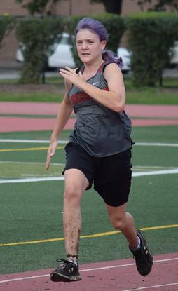
Ella Gand Sedeita
Meet | Date | Dist. | Finish Time | PPM
Home vs. ZB, Warren, Mather | 8/29 | 2 | 18:43 | 9:22
Lake Park Invite | 9/14 | 2 | 18:13 | 9:06
Main West Quad | 9/17 | 2 | 19:13 | 9:37
VH Quad | 9/24 | 2 | 21:40 | 10:40
Whitney Young Invite | 9/28 | 2 | 20:29 | 10:14
Niles West Invite | 10/5 | 2 | 19:47 | 9:53
Conference | 10/20 | 2 | 19:03 | 9:31

Slide 9
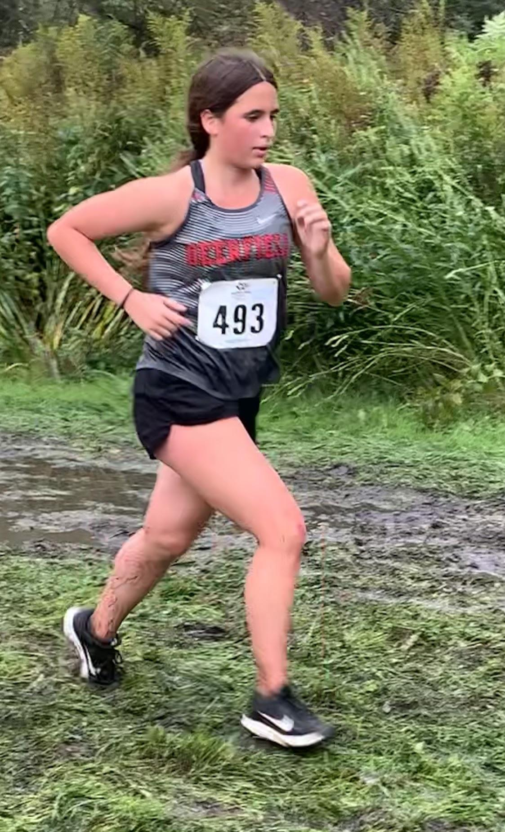
Kasey Lubeck
Meet | Date | Dist. | Finish Time | PPM
Home vs. ZB, Warren, Mather | 8/29 | 2 | 18:43 | 9:22
Lake Park Invite | 9/14 | 2 | 18:13 | 9:06
Main West Quad | 9/17 | 2 | 19:13 | 9:37
Peoria/Libertyville | 9/21 | 3 | 31:39 | 10:55
VH Quad | 9/24 | 2 | 21:40 | 10:40
Whitney Young Invite | 9/28 | 2 | 20:29 | 10:14
Niles West Invite | 10/5 | 2 | 19:47 | 9:53
Conference | 10/20 | 2 | 19:03 | 9:31

Slide 10
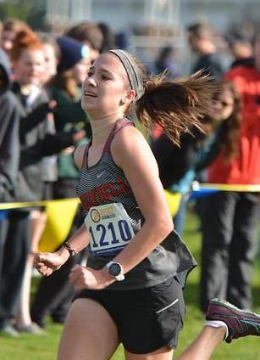
Lexi Schott
Meet | Date | Dist. | Finish Time | PPM
Home vs. ZB, Warren, Mather | 8/29 | 2 | 14:54 | 7:27
Lake County | 9/4 | 3.1 | 22:20 | 7:12
Lake Park Invite | 9/14 | 3 | 21:49 | 7:16
Main West Quad | 9/17 | 3 | 22:15 | 7:25
Peoria/Libertyville | 9/21 | 3 | 21:38 | 7:13
VH Quad | 9/24 | 3 | 21:40 | 7:13
Whitney Young Invite | 9/28 | 3 | 20:29 | 6:49
Niles West Invite | 10/5 | 3 | 22:00 | 7:20
Conference | 10/20 | 3 | 21:02 | 7:00
Regional | 10/26 | 3 | 19:31 | 6:30
Sectional | 11/2 | 3 | 20:30 | 6:50

Slide 11
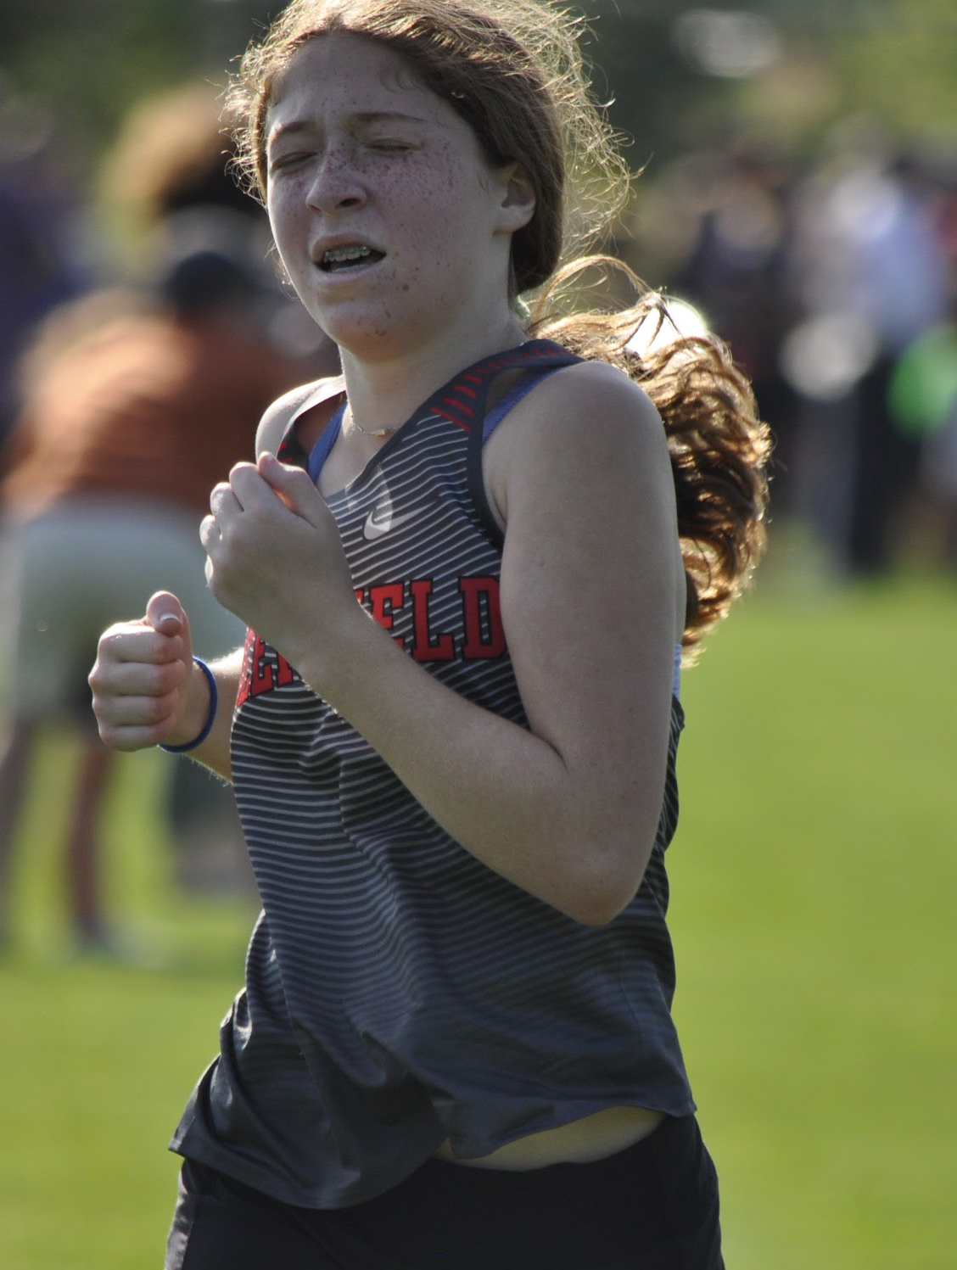
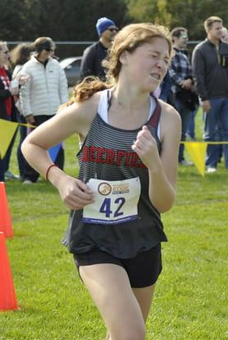
Hannah Rush
Meet | Date | Dist. | Finish Time | PPM
Home vs. ZB, Warren, Mather | 8/29 | 2 | 16:33 | 8:17
Lake County | 9/4 | 3.1 | 24:30 | 7:54
Lake Park Invite | 9/14 | 3 | 23:50 | 7:56
Main West Quad | 9/17 | 3 | 23:19 | 7:46
VH Quad | 9/24 | 3 | 23:39 | 7:53
Whitney Young Invite | 9/28 | 3 | 22:18 | 7:26
Conference | 10/20 | 3 | 21:38 | 7:12

Slide 12
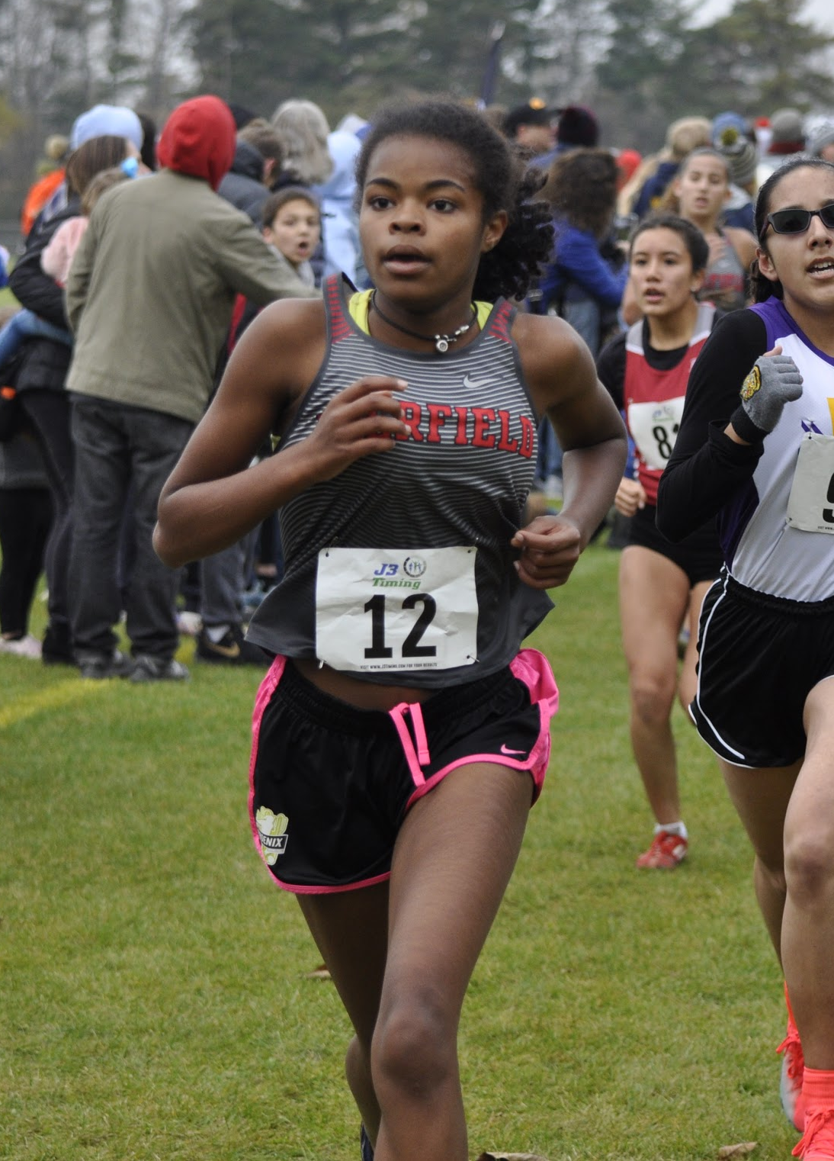
Lauren Barber
Meet | Date | Dist. | Finish Time | PPM
Home vs. ZB, Warren, Mather | 8/29 | 2 | 14:07 | 7:04
Lake County | 9/4 | 3.1 | 23:35 | 7:37
Main West Quad | 9/17 | 3 | 23:10 | 7:43
Peoria/Libertyville | 9/21 | 3 | 22:41 | 7:34
VH Quad | 9/24 | 3 | 23:21 | 7:47
Whitney Young Invite | 9/28 | 3 | 22:15 | 7:25
Niles West Invite | 10/5 | 3 | 23:15 | 7:45
Conference | 10/20 | 3 | 21:10 | 7:03
Regional | 10/26 | 3 | 19:57 | 6:39

Slide 13
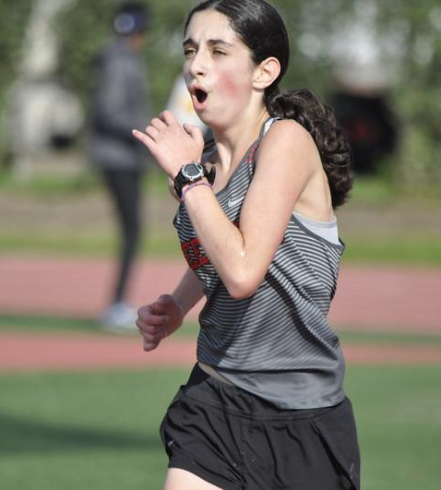
Lily Hecht
Meet | Date | Dist. | Finish Time | PPM
Home vs. ZB, Warren, Mather | 8/29 | 2 | 17:34 | 8:47
Lake Park Invite | 9/14 | 2 | 16:17 | 8:08
Main West Quad | 9/17 | 3 | 26:18 | 8:46
Peoria/Libertyville | 9/21 | 3 | 28:01 | 9:20
VH Quad | 9/24 | 2 | 17:24 | 8:42
Whitney Young Invite | 9/28 | 3 | 26:41 | 8:53
Niles West Invite | 10/5 | 3 | 25:48 | 8:36
Conference | 10/20 | 3 | 25:42 | 8:34

Slide 14
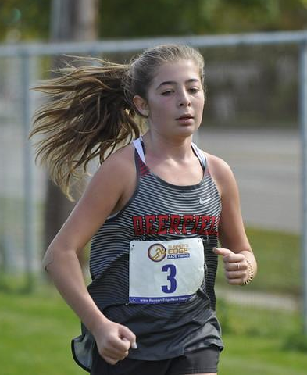
Sydney Ban
Meet | Date | Dist. | Finish Time | PPM
Home vs. ZB, Warren, Mather | 8/29 | 2 | 18:04 | 9:02
Lake Park Invite | 9/14 | 2 | 16:16 | 8:08
Main West Quad | 9/17 | 3 | 26:19 | 8:46
Peoria/Libertyville | 9/21 | 3 | 27:59 | 9:20
VH Quad | 9/24 | 2 | 17:01 | 8:30
Whitney Young Invite | 9/28 | 3 | 25:09 | 8:23
Niles West Invite | 10/5 | 3 | 25:42 | 8:34
Conference | 10/20 | 3 | 23:19 | 7:46

Slide 15
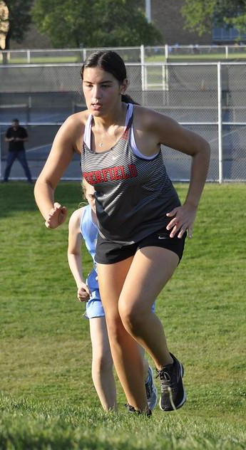
Sofia Gorgees
Meet | Date | Dist. | Finish Time | PPM
Home vs. ZB, Warren, Mather | 8/29 | 2 | 20:03 | 10:02
Lake Park Invite | 9/14 | 2 | 17:58 | 8:59
Main West Quad | 9/17 | 2 | 23:11 | 11:36
Peoria/Libertyville | 9/21 | 3 | 33:30 | 11:10

Slide 16
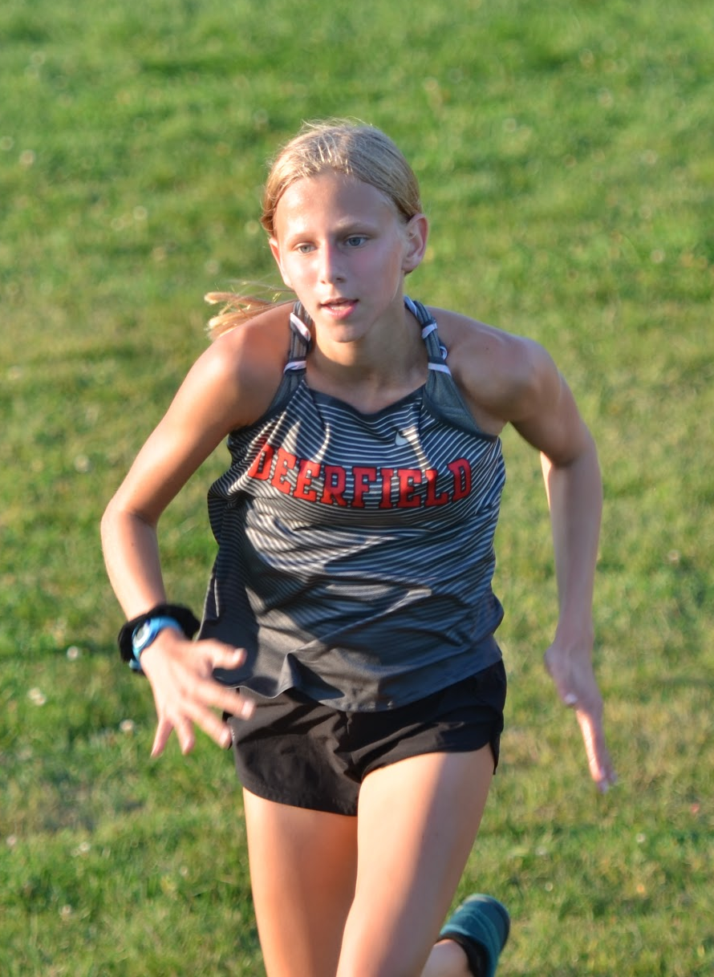
Leah Ryan
Meet | Date | Dist. | Finish Time | PPM
Home vs. ZB, Warren, Mather | 8/29 | 2 | 13:40 | 6:50
Lake County | 9/4 | 3.1 | 22:4 | 7:07
Lake Park Invite | 9/14 | 3 | 21:05 | 7:02
Main West Quad | 9/17 | 3 | 21:25 | 7:08
Peoria/Libertyville | 9/21 | 3 | 21:06 | 7:02
VH Quad | 9/24 | 3 | 23:11 | 7:43
Whitney Young Invite | 9/28 | 3 | 22:48 | 7:36
Niles West Invite | 10/5 | 3 | 22:36 | 7:32
Conference | 10/20 | 3 | 21:45 | 7:15

Slide 17
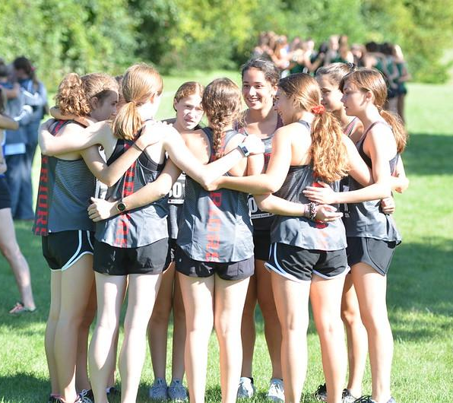
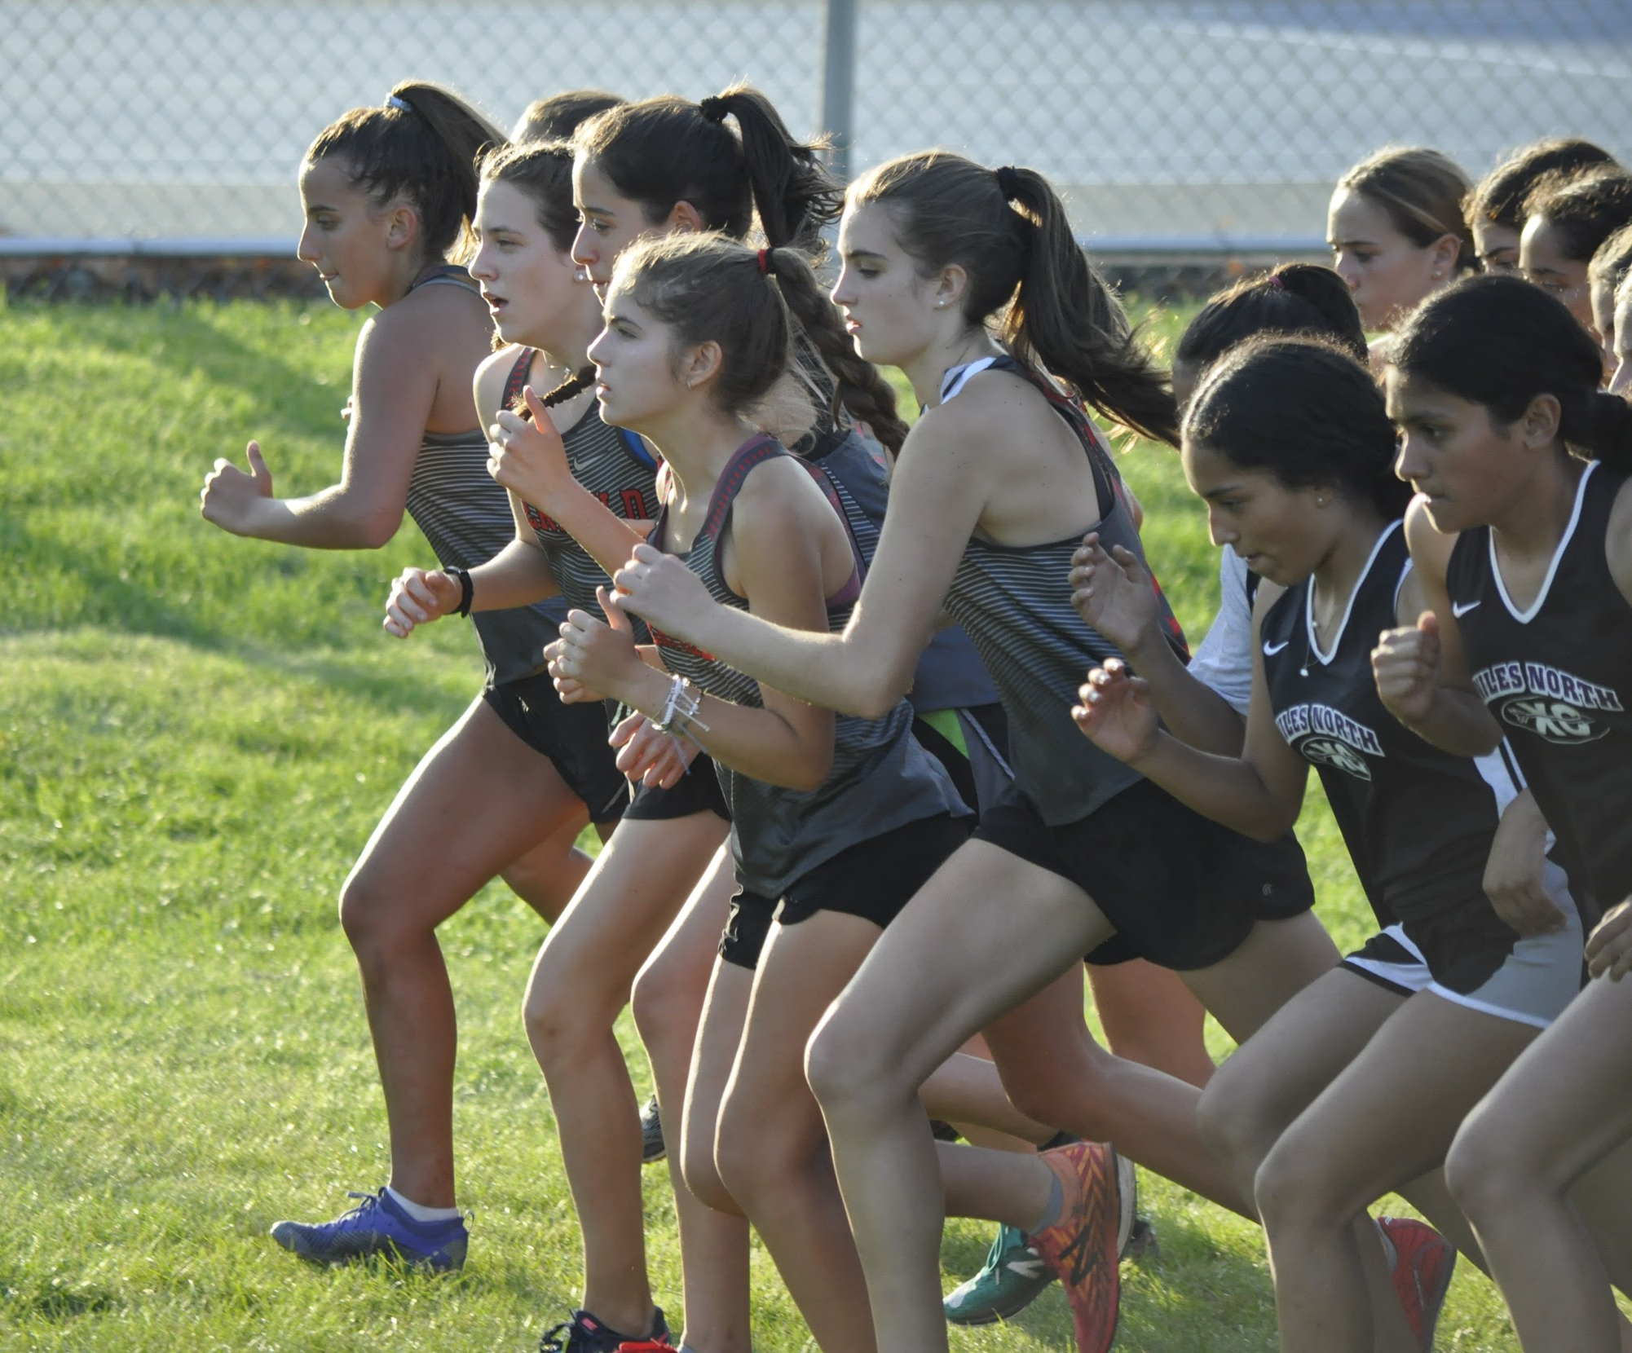
SOPHOMORES

Slide 18
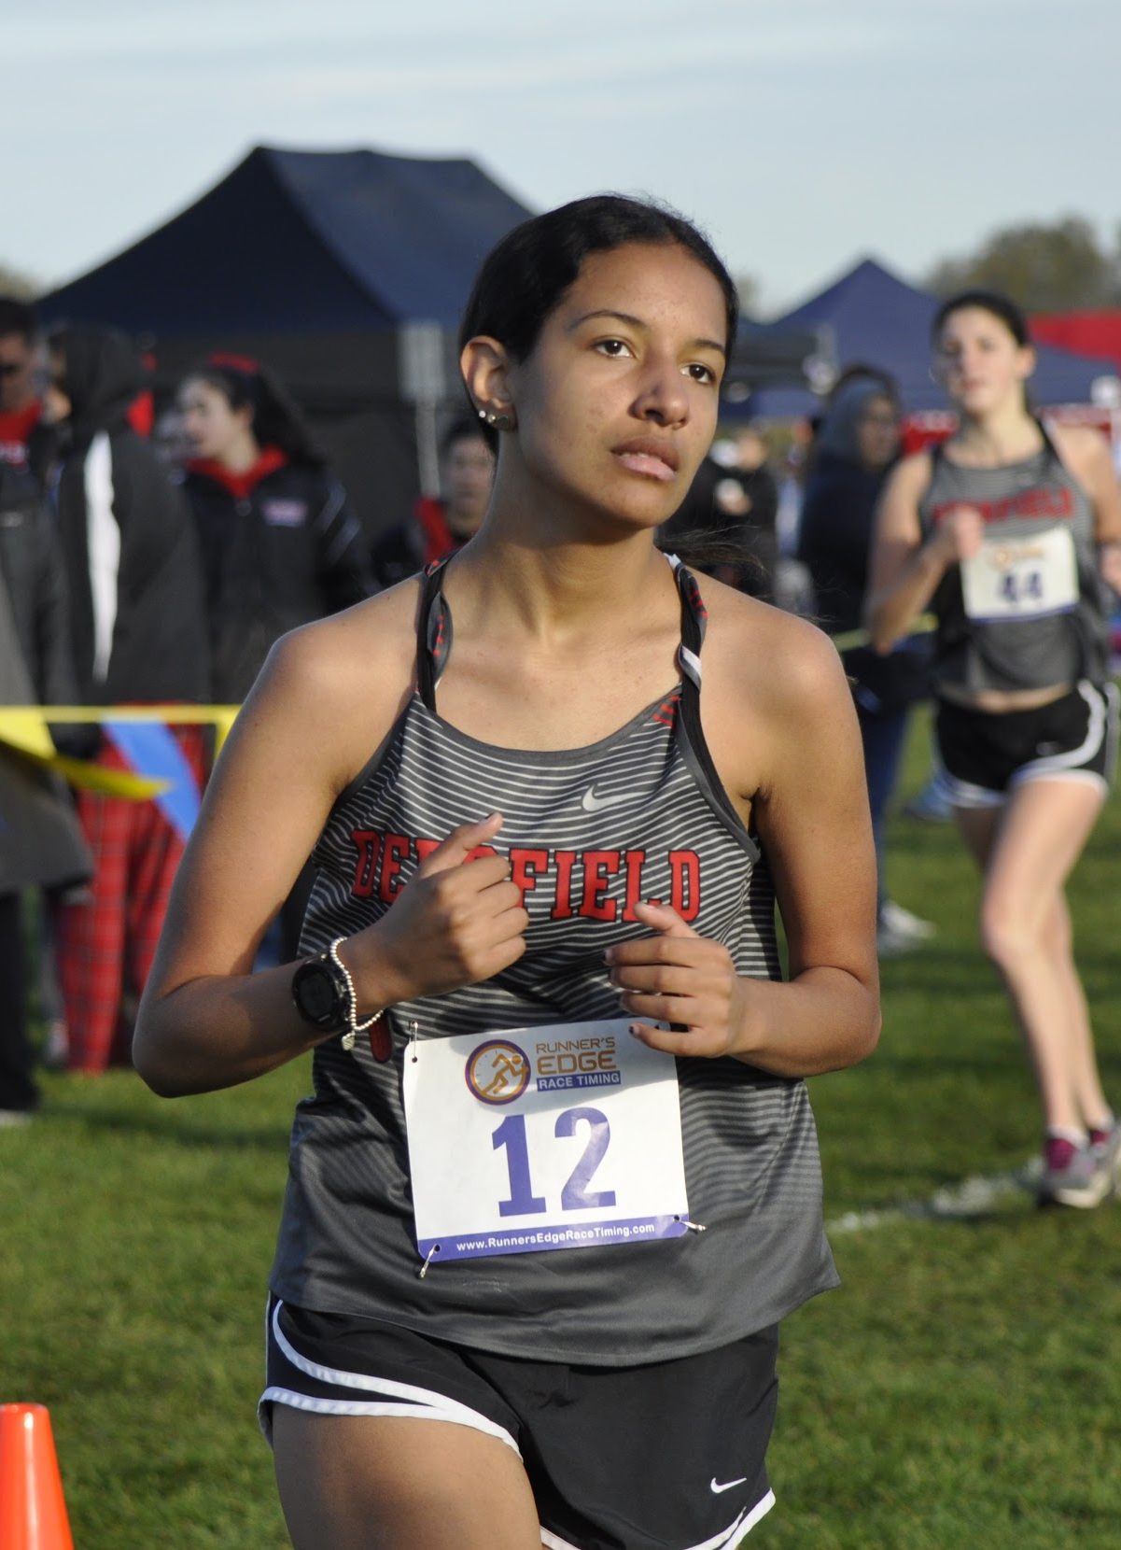
Nicole Cooper
Meet | Date | Dist. | Finish Time | PPM
Lake Park Invite | 9/14 | 2mi | 20:30 | 10:15
VH Quad | 9/24 | 2mi | 22:20 | 11:10
Conference | 10/20 | 2mi | 19:41 | 9:50

Slide 19

Moraya Adeyemi
Meet | Date | Dist. | Finish Time | PPM
Home vs. ZB, Warren, Mather | 8/29 | 2 | 19:18 | 9:39
Lake Park Invite | 9/14 | 2 | 19:19 | 9:40
Main West Quad | 9/17 | 2 | 22:50 | 11:25
Peoria/Libertyville | 9/21 | 3 | 31:47 | 10:36
VH Quad | 9/24 | 2 | 20:03 | 10:01
Whitney Young Invite | 9/28 | 2 | 18:40 | 9:20
Niles West Invite | 10/5 | 2 | 18:52 | 9:26
Conference | 10/20 | 2 | 19:05 | 9:32

Slide 20
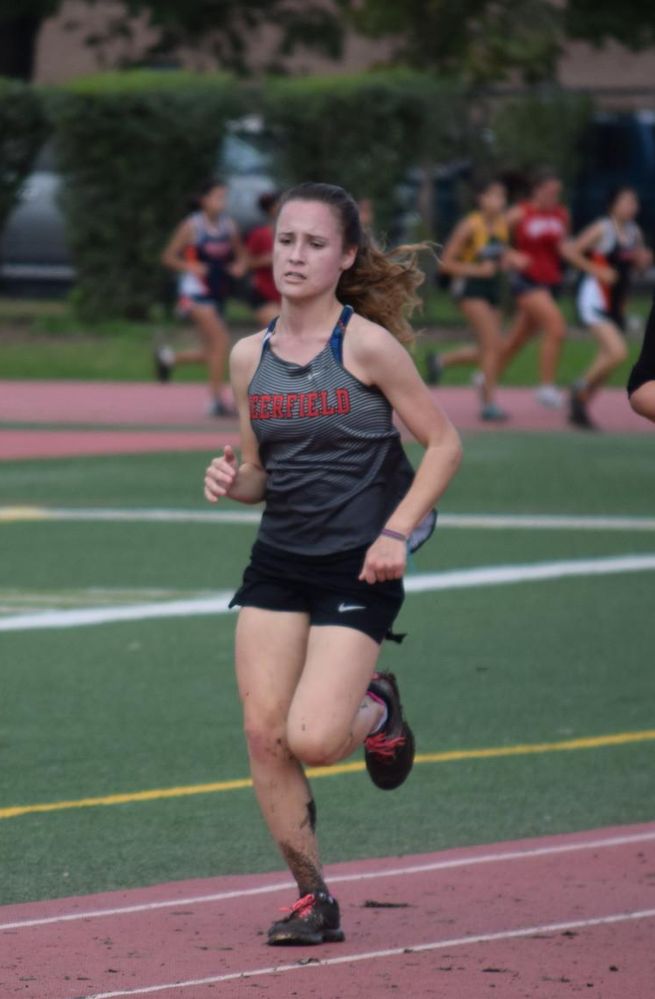
Hannah Kemist
Meet | Date | Dist. | Finish Time | PPM
Home vs. ZB, Warren, Mather | 8/29 | 2 | 19:17 | 9:39
Lake Park Invite | 9/14 | 2 | 18:03 | 9:01
VH Quad | 9/24 | 2 | 18:49 | 9:25
Niles West Invite | 10/5 | 2 | 18:04 | 9:02

Slide 21
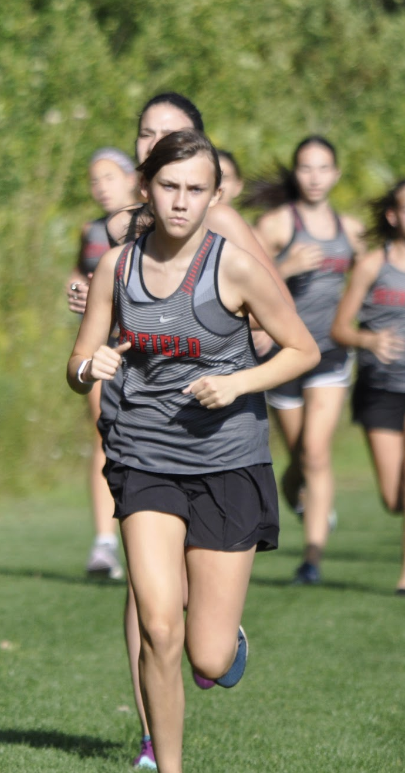
Lila koenig
Meet | Date | Dist. | Finish Time | PPM
Home vs. ZB, Warren, Mather | 8/29 | 2 | 15:08 | 7:34
Lake County | 9/4 | 3.1 | 23:34 | 7:36
Lake Park Invite | 9/14 | 3 | 24:00 | 8:00
Main West Quad | 9/17 | 3 | 23:12 | 7:44
Peoria/Libertyville | 9/21 | 3 | 22:57 | 7:39
VH Quad | 9/24 | 3 | 23:42 | 7:54
Whitney Young Invite | 9/28 | 3 | 22:52 | 7:37
Niles West Invite | 10/5 | 3 | 23:39 | 7:53
Conference | 10/20 | 3 | 22:07 | 7:22

Slide 22
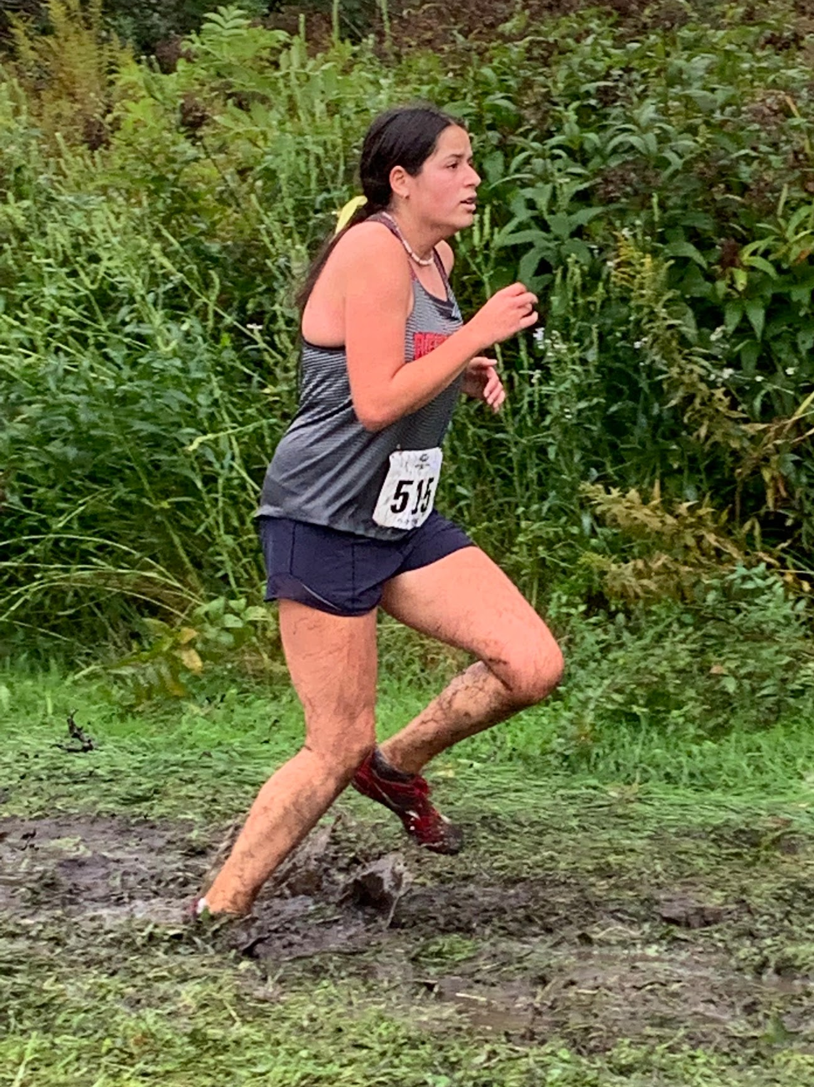
Chloe Wolk
Meet | Date | Dist. | Finish Time | PPM
Lake Park Invite | 9/14 | 2 | 15:37 | 7:48
Maine West Quad | 9/17 | 3 | 26:30 | 8:50
Peoria/Libertyville | 9/21 | 3 | 27:59 | 9:20
VH Quad | 9/24 | 2 | 16:27 | 8:14
Whitney Young Invite | 9/28 | 2 | 15:37 | 7:48
Niles West Invite | 10/5 | 2 | 15:47 | 7:53
Conference | 10/20 | 2 | 14:32 | 7:16

Slide 23
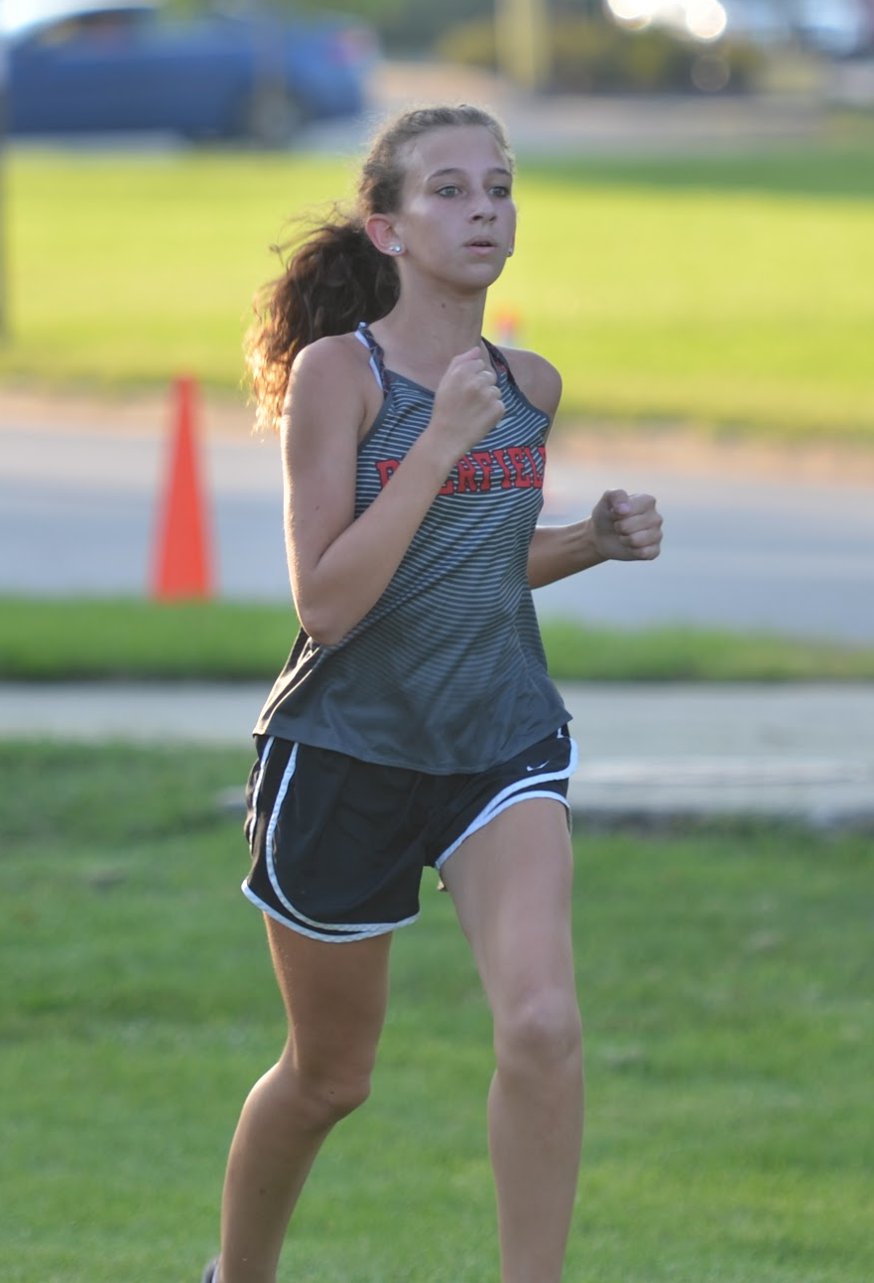
Ally Geren
Meet | Date | Dist. | Finish Time | PPM
Home vs. ZB, Warren, Mather | 8/29 | 2 | 15:57 | 7:59
Lake County | 9/4 | 3.1 | 23:46 | 7:40
Lake Park Invite | 9/14 | 3 | 23:50 | 7:56
Main West Quad | 9/17 | 3 | 23:11 | 7:44
Peoria/Libertyville | 9/21 | 3 | 23:5 | 7:42
VH Quad | 9/24 | 3 | 23:22 | 7:47
Whitney Young Invite | 9/28 | 3mi | 22:20 | 7:26
Niles West Invite | 10/5 | 3mi | 23:05 | 7:41
Conference | 10/20 | 3mi | 21:47 | 7:15

Slide 24
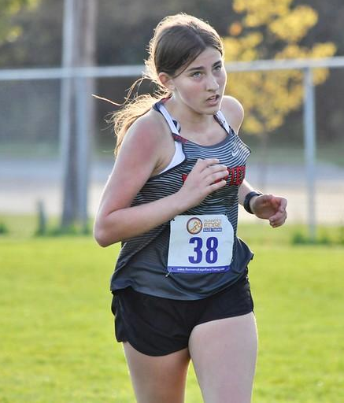
Maggie Montgomery
Meet | Date | Dist. | Finish Time | PPM
Lake Park Invite | 9/14 | 2mi | 17:57 | 8:58
Main West Quad | 9/17 | 2 | 21:24 | 10:42
VH Quad | 9/24 | 2mi | 19:08 | 9:34
Whitney Young Invite | 9/28 | 2mi | 18:00 | 9:00
Niles West Invite | 10/5 | 2mi | 18:43 | 9:21
Conference | 10/20 | 2mi | 16:57 | 8:28

Slide 25
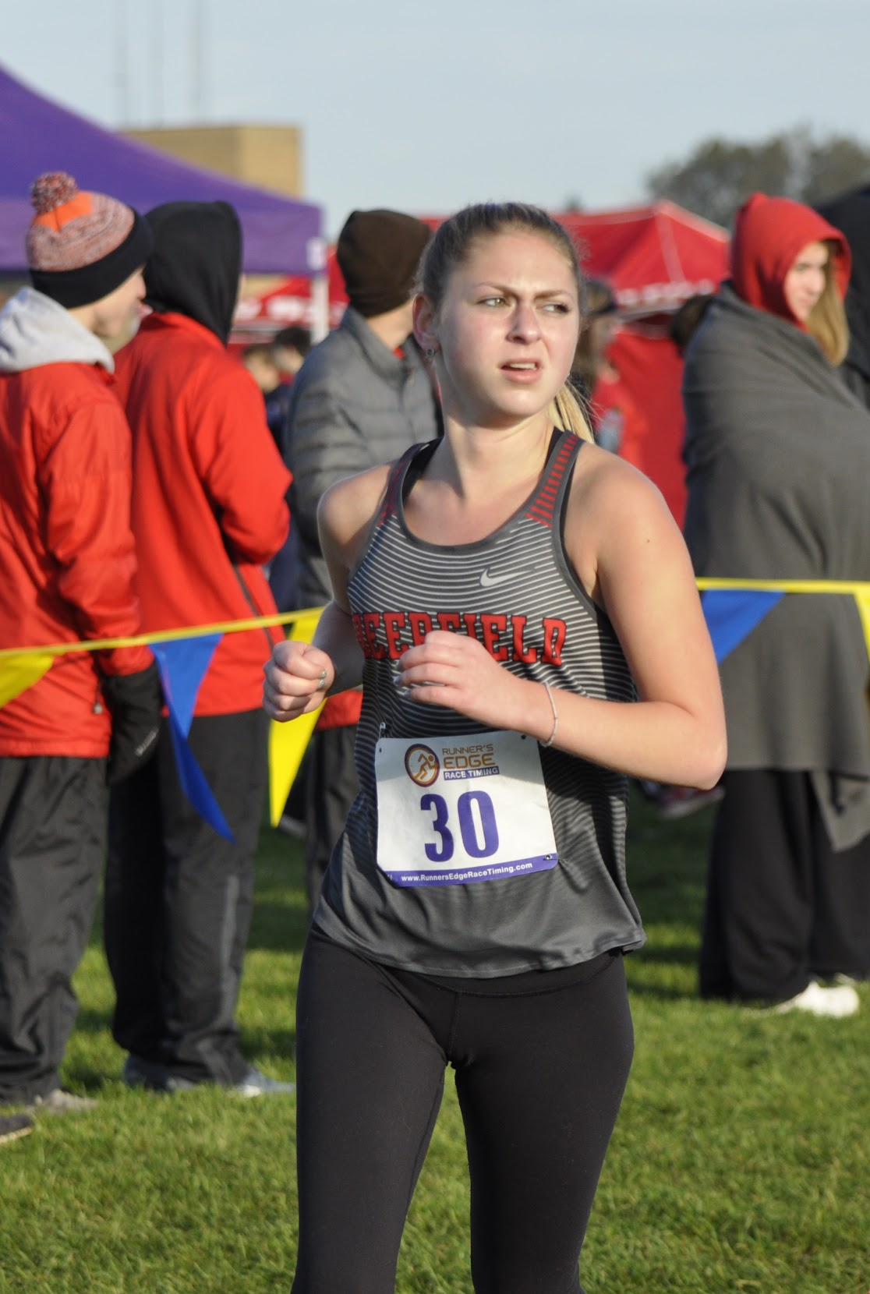
Bella Kolton
Meet | Date | Dist. | Finish Time | PPM
Home vs. ZB, Warren, Mather | 8/29 | 2 | 18:17 | 9:09
Lake Park Invite | 9/14 | 2mi | 17:37 | 8:48
Main West Quad | 9/17 | 2 | 20:29 | 10:15
Conference | 10/20 | 2mi | 18:08 | 9:04

Slide 26
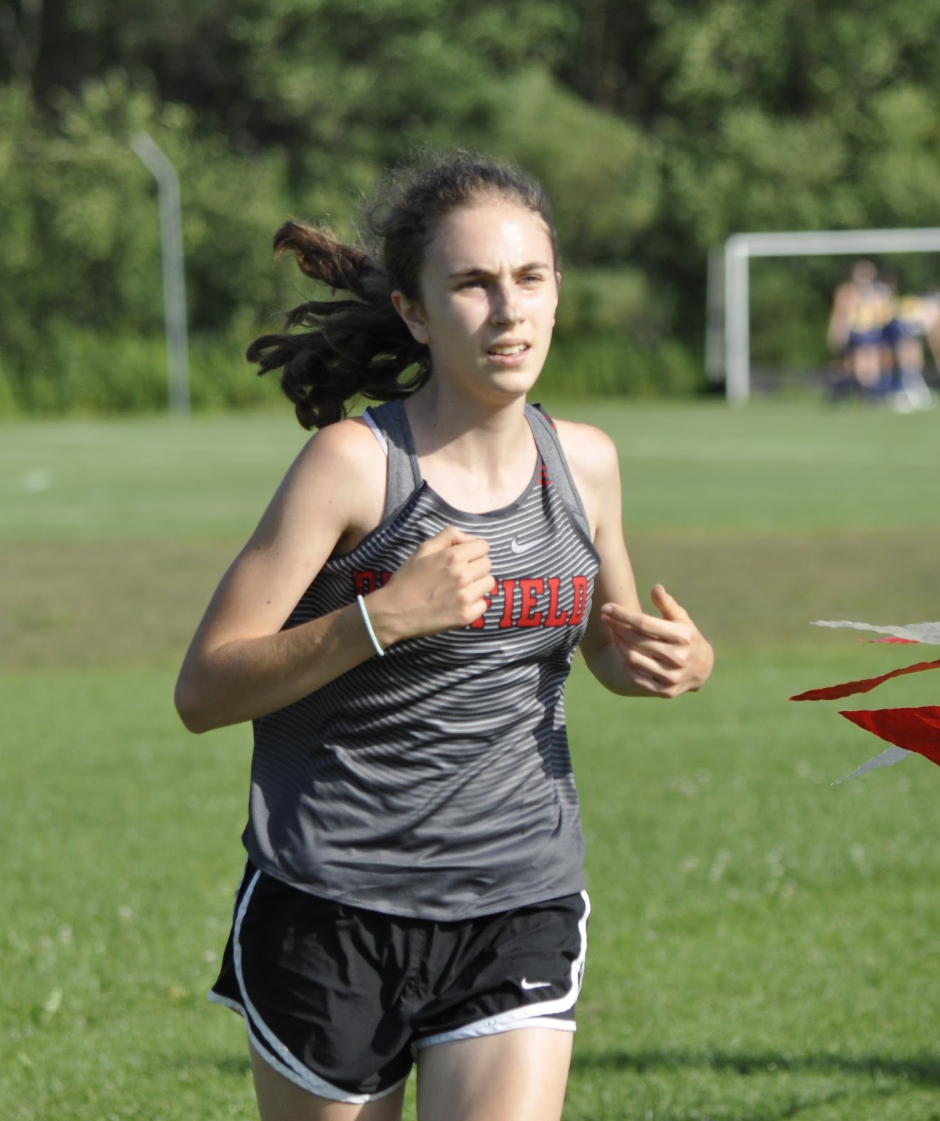
Bekah Firestone
Meet | Date | Dist. | Finish Time | PPM
Home vs. ZB, Warren, Mather | 8/29 | 2 | 15:02 | 7:31
Lake County | 9/4 | 3.1 | 23:33 | 7:36
Lake Park Invite | 9/14 | 3mi | 23:47 | 7:56
Main West Quad | 9/17 | 3 | 23:02 | 7:41
Peoria/Libertyville | 9/21 | 3 | 22:5 | 7:22
VH Quad | 9/24 | 3mi | 23:40 | 7:53
Whitney Young Invite | 9/28 | 3mi | 23:09 | 7:43
Niles West Invite | 10/5 | 3mi | 22:50 | 7:37
Conference | 10/20 | 3mi | 22:21 | 7:27

Slide 27
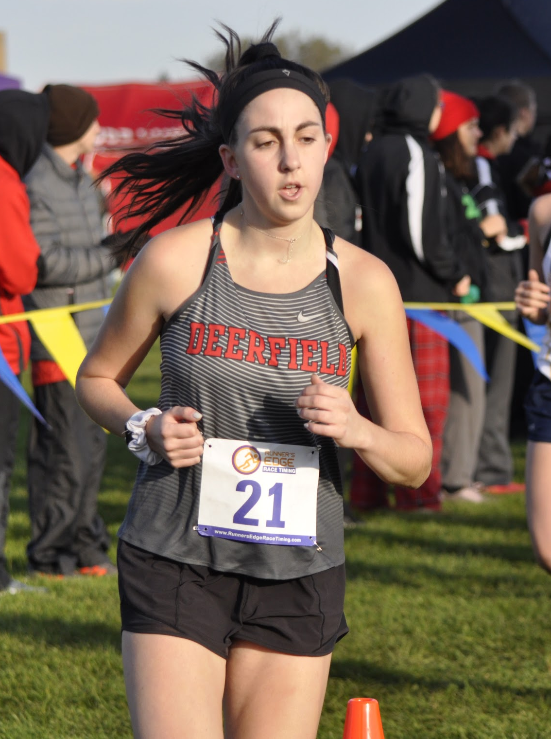
Erika Gerol
Meet | Date | Dist. | Finish Time | PPM
Home vs. ZB, Warren, Mather | 8/29 | 2 | 17:35 | 8:48
Lake Park Invite | 9/14 | 2mi | 15:51 | 7:55
Peoria/Libertyville | 9/21 | 3 | 28:01 | 9:20
VH Quad | 9/24 | 2mi | 16:46 | 8:23
Whitney Young Invite | 9/28 | 2mi | 16:19 | 8:10
Niles West Invite | 10/5 | 2mi | 17:00 | 8:30
Conference | 10/20 | 2mi | 15:36 | 7:48

Slide 28
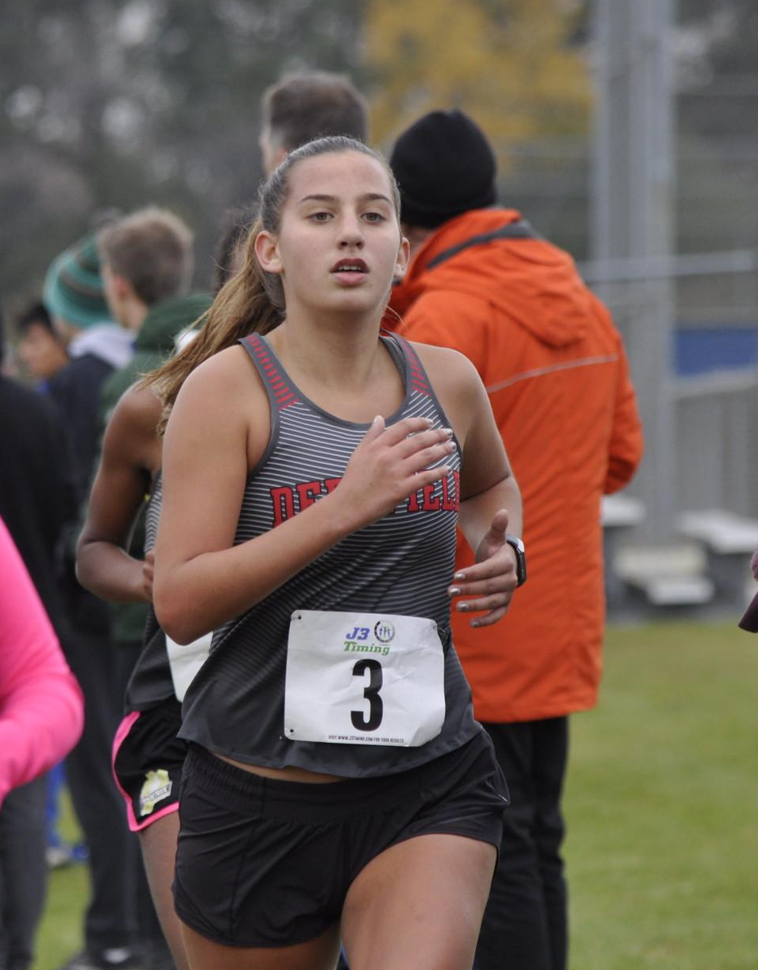
Annie Fisher
Meet | Date | Dist. | Finish Time | PPM
Home vs. ZB, Warren, Mather | 8/29 |  | :
Lake County | 9/4 |  | :
Lake Park Invite | 9/14 | 2mi | 14:18 | 7:09
Main West Quad | 9/17 | 3 | 23:13 | 7:44
Peoria/Libertyville | 9/21 | 3 | 21:20 | 7:07
VH Quad | 9/24 | 3mi | 23:32 | 7:50
Whitney Young Invite | 9/28 | 3mi | 21:48 | 7:16
Niles West Invite | 10/5 | 3mi | 21:25 | 7:08
Conference | 10/20 | 3mi | 21:22 | 7:07
Regional | 10/26 | 3 | 20:00 | 6:21

Slide 29

Mia Weinberg

Slide 30
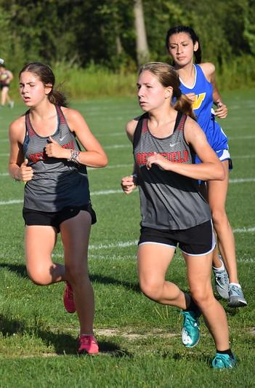
Caroline Reich
Meet | Date | Dist. | Finish Time | PPM
Home vs. ZB, Warren, Mather | 8/29 | 3 | 21:29 | 7:10
Lake County | 9/4 | 3.1 | 21:16 | 6:52
Lake Park Invite | 9/14 | 3mi | 20:07 | 6:42
Main West Quad | 9/17 | 3 | 21:20 | 7:07
Peoria/Libertyville | 9/21 | 3 | 19:59 | 6:40
VH Quad | 9/24 | 3mi | 23:00 | 7:40
Whitney Young Invite | 9/28 | 3mi | 21:19 | 7:08
Niles West Invite | 10/5 | 3mi | 20:16 | 6:45
Conference | 10/20 | 3mi | 20:08 | 6:42
Regional | 10/26 | 3 | 19:14 | 6:25
Sectional | 11/2 | 3 | 20:37 | 6:52

Slide 31
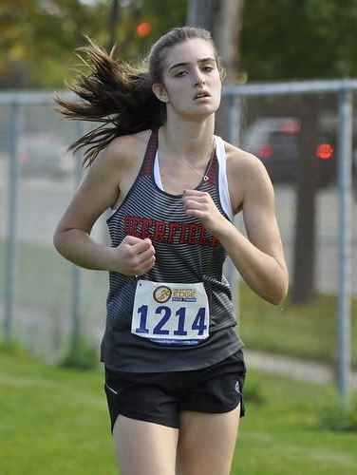
Madeline Trella
Meet | Date | Dist. | Finish Time | PPM
Home vs. ZB, Warren, Mather | 8/29 | 3 | 22:1 | 7:20
Lake County | 9/4 | 3.1 | 21:32 | 6:57
Lake Park Invite | 9/14 | 3mi | 23:14
Main West Quad | 9/17 | 3 | 22:24 | 7:28
Peoria/Libertyville | 9/21 | 3 | 21:55 | 7:18
VH Quad | 9/24 | 3mi | 23:19 | 7:46
Whitney Young Invite | 9/28 | 3mi | 22:51 | 7:37
Niles West Invite | 10/5 | 3mi | 23:40 | 7:53
Conference | 10/20 | 3mi | 24:12 | 8:09

Slide 32
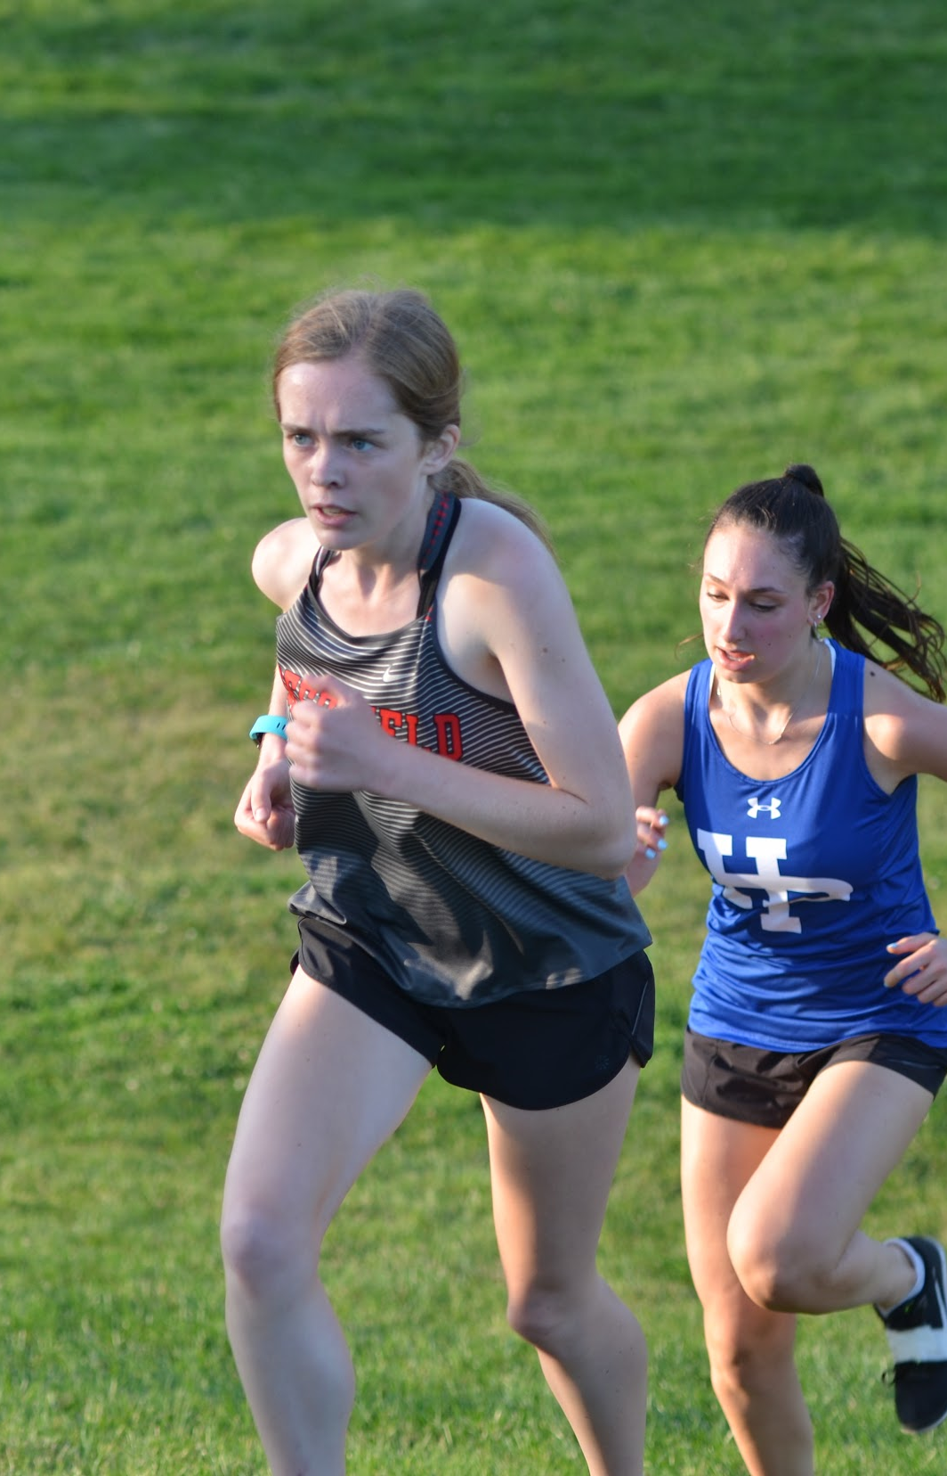
Serena Worley
Meet | Date | Dist. | Finish Time | PPM
Home vs. ZB, Warren, Mather | 8/29 | 3 | 23:18 | 7:43
Lake County | 9/4 | 3.1 | 23:00 | 7:55
Lake Park Invite | 9/14 | 3mi | 26:28 | 8:49
Main West Quad | 9/17 | 3 | 27:27 | 9:09
Peoria/Libertyville | 9/21 | 3 | 25:59 | 8:40
VH Quad | 9/24 | 2mi | 16:10 | 8:05
Whitney Young Invite | 9/28 | 2mi | 15:25 | 7:42
Niles West Invite | 10/5 | 3mi | 25:16 | 8:25
Conference | 10/20 | 3mi | 23:34 | 7:51

Slide 33
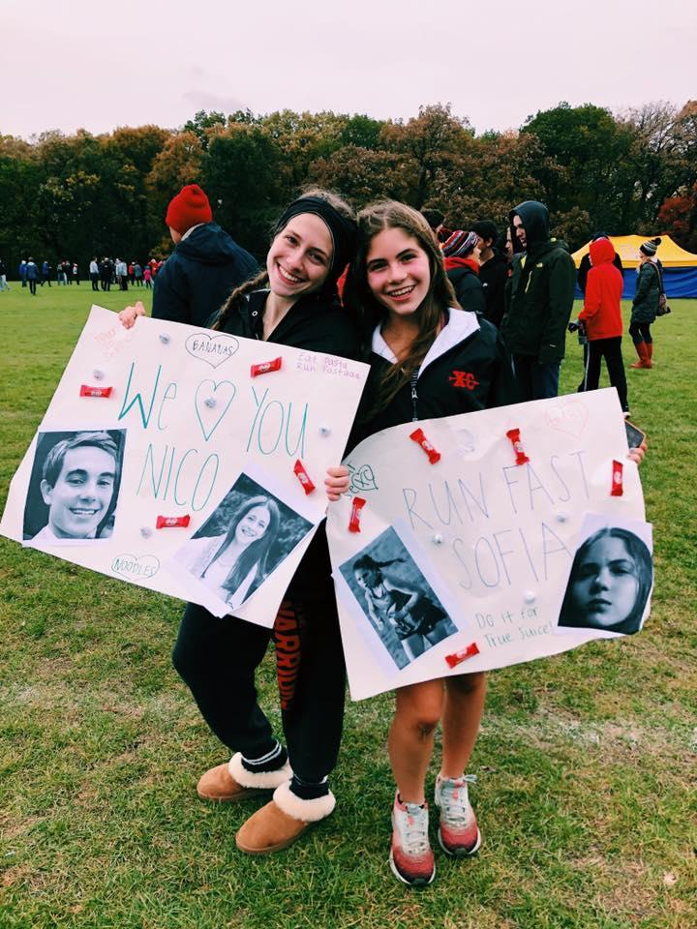
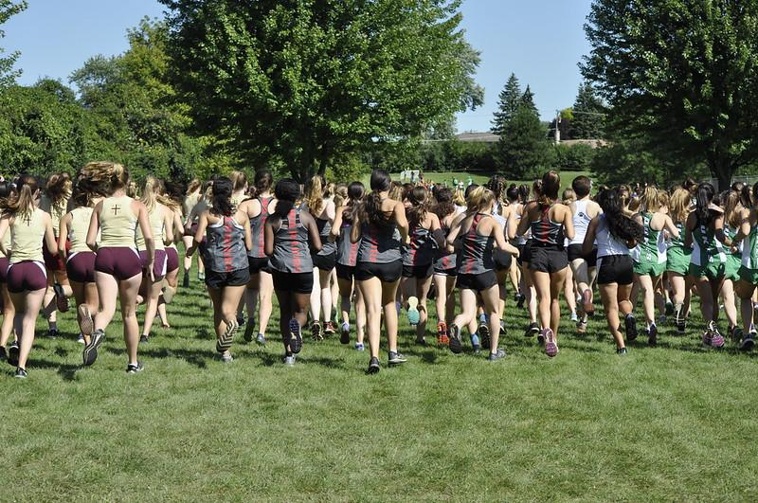
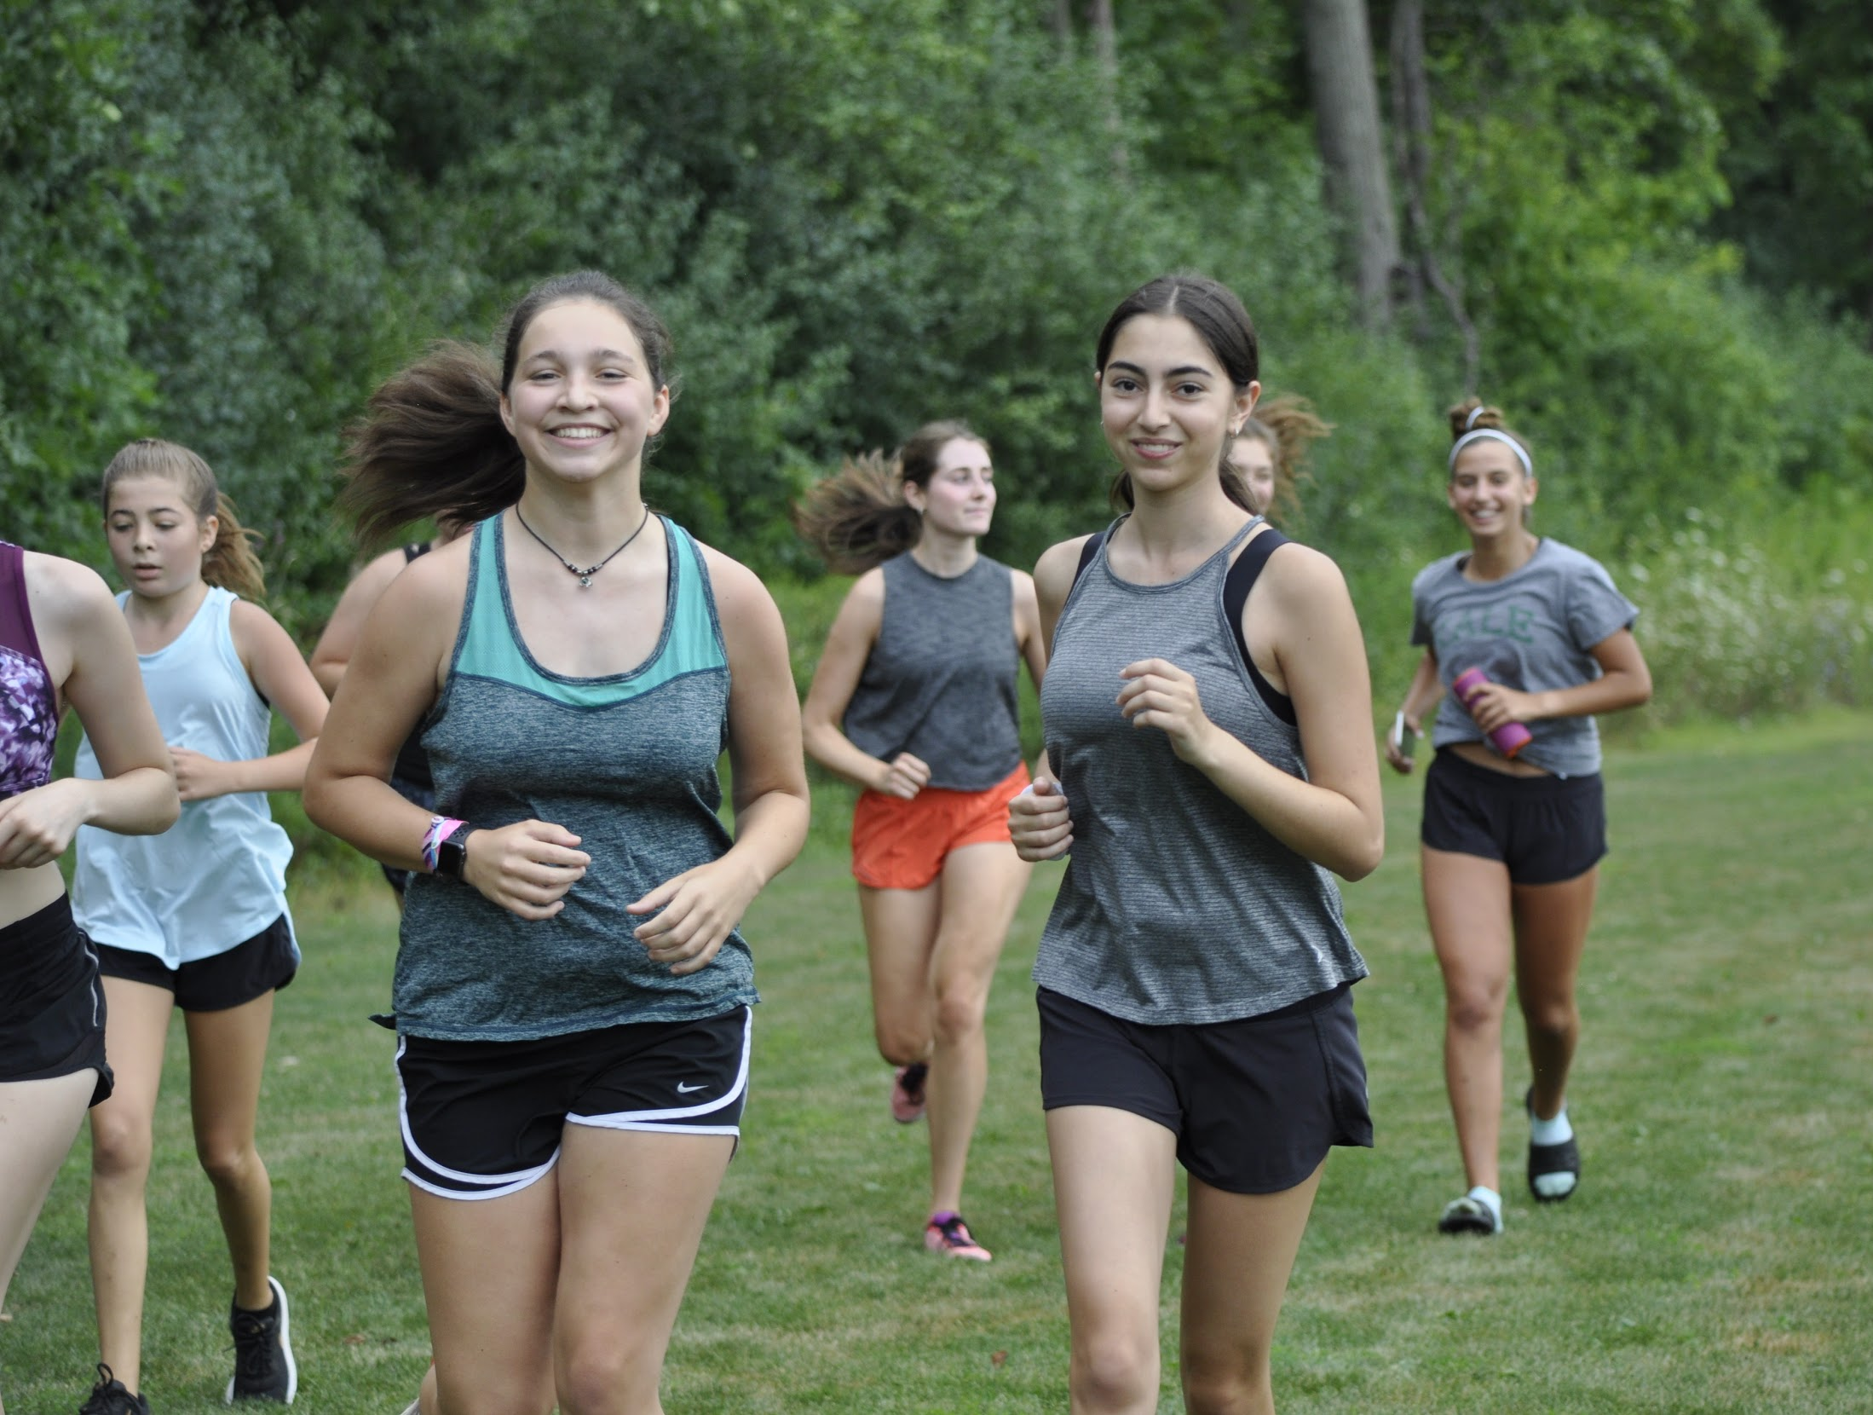
JUNIORS

Slide 34
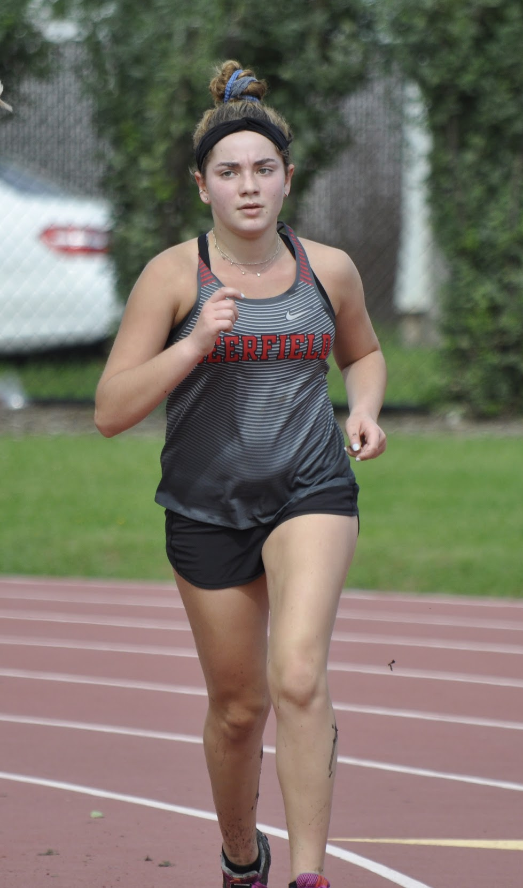
Hannah Krengel
Meet | Date | Dist. | Finish Time | PPM
Home vs. ZB, Warren, Mather | 8/29 | 2 | 17:57 | 8:59
Lake Park Invite | 9/14 | 2mi | 15:45 | 7:52
Main West Quad | 9/17 | 3 | 26:12 | 8:44
Peoria/Libertyville | 9/21 | 3 | 28:32 | 9:31
VH Quad | 9/24 | 2mi | 16:55 | 8:27
Whitney Young Invite | 9/28 | 2mi | 16:03 | 8:01
Niles West Invite | 10/5 | 2mi | 16:36 | 8:18
Conference | 10/20 | 2mi | 15:42 | 7:51

Slide 35
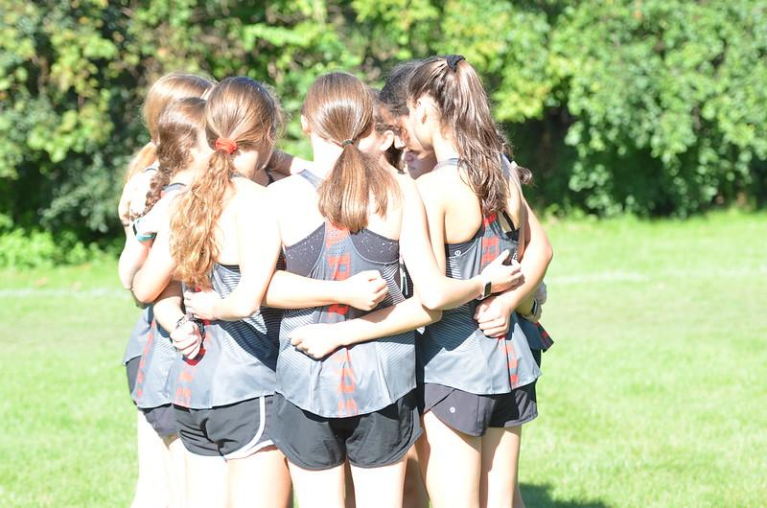
Jocelyn Katz

Slide 36
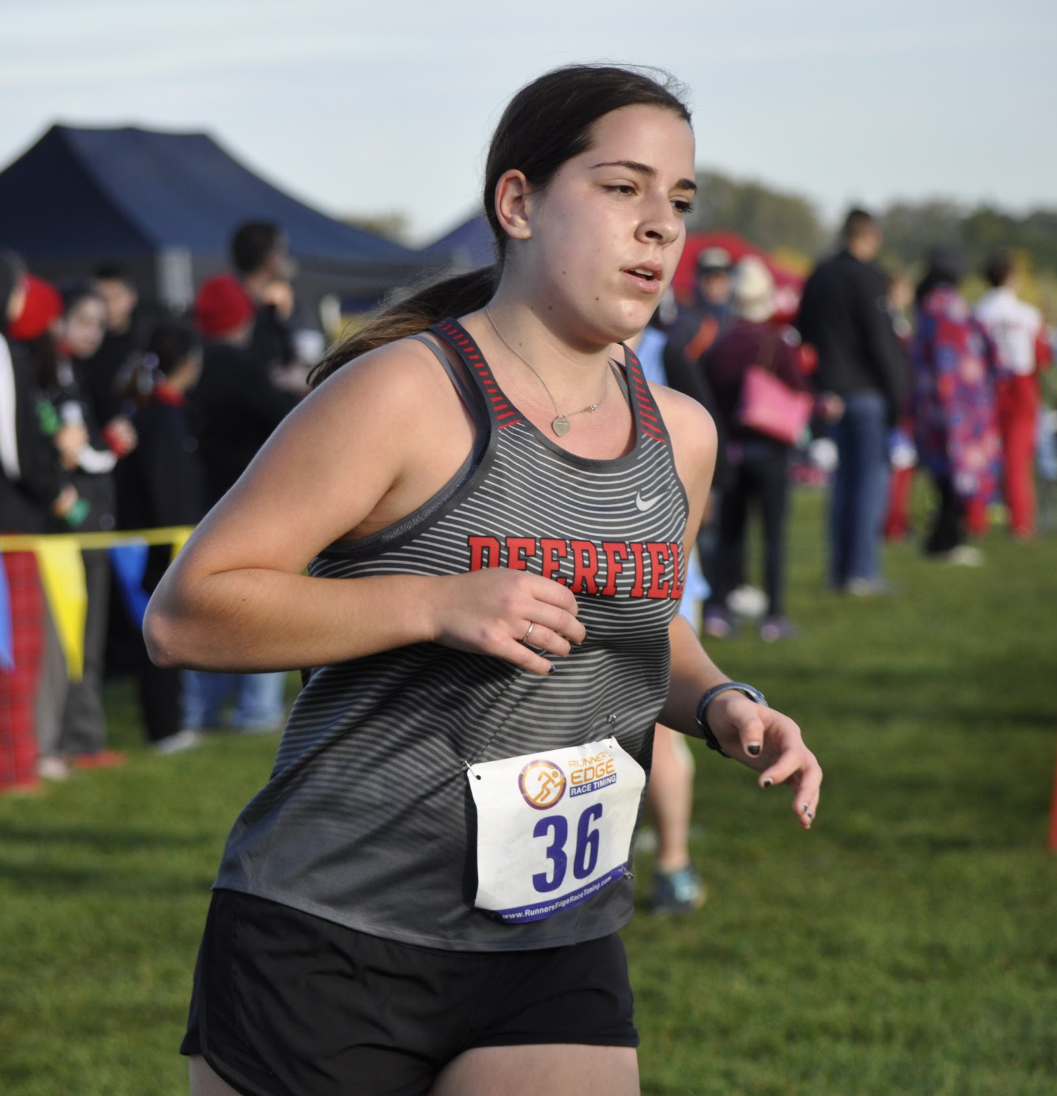
Hollie Lyons
Meet | Date | Dist. | Finish Time | PPM
Main West Quad | 9/17 | 2 | 18:37 | 9:19
VH Quad | 9/24 | 2mi | 17:10 | 8:35
Conference | 10/20 | 2mi | 16:23 | 8:12

Slide 37
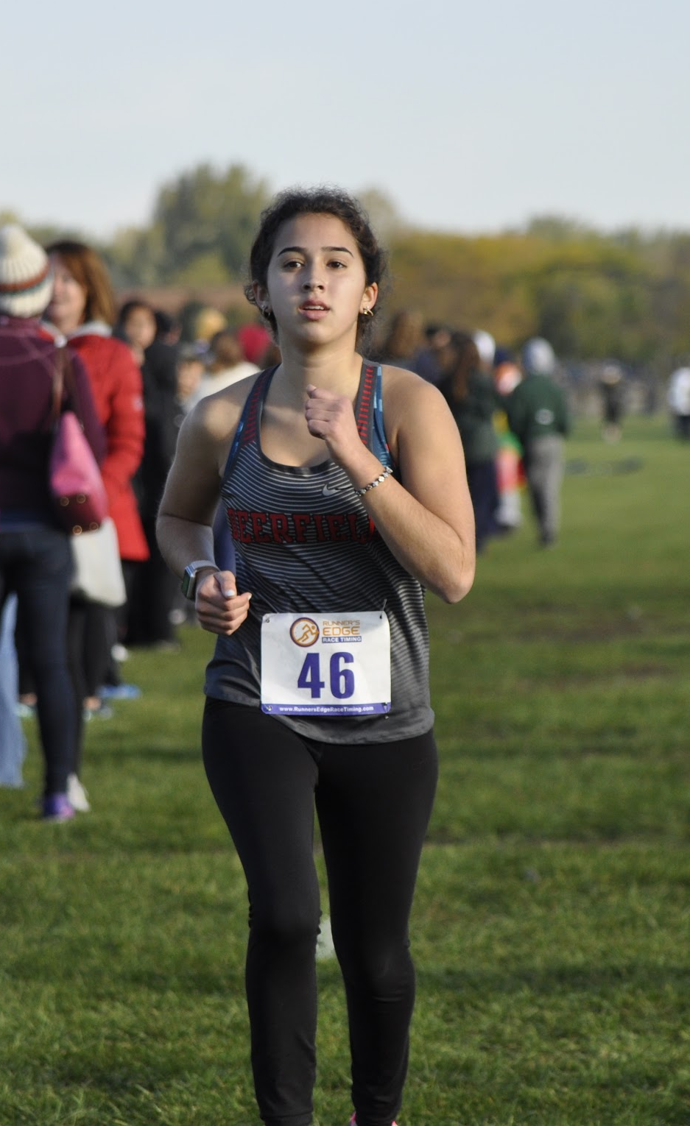
Emmy St John
Meet | Date | Dist. | Finish Time | PPM
Home vs. ZB, Warren, Mather | 8/29 | 2 | 16:19 | 8:09
Lake County | 9/4 | 3.1 | 24:23 | 7:51
Main West Quad | 9/17 | 3 | 24:31 | 8:10
Peoria/Libertyville | 9/21 | 3 | 27:53 | 9:21
Niles West Invite | 10/5 | 2mi | 15:35 | 7:47
Conference | 10/20 | 2 | 14:42 | 7:21

Slide 38
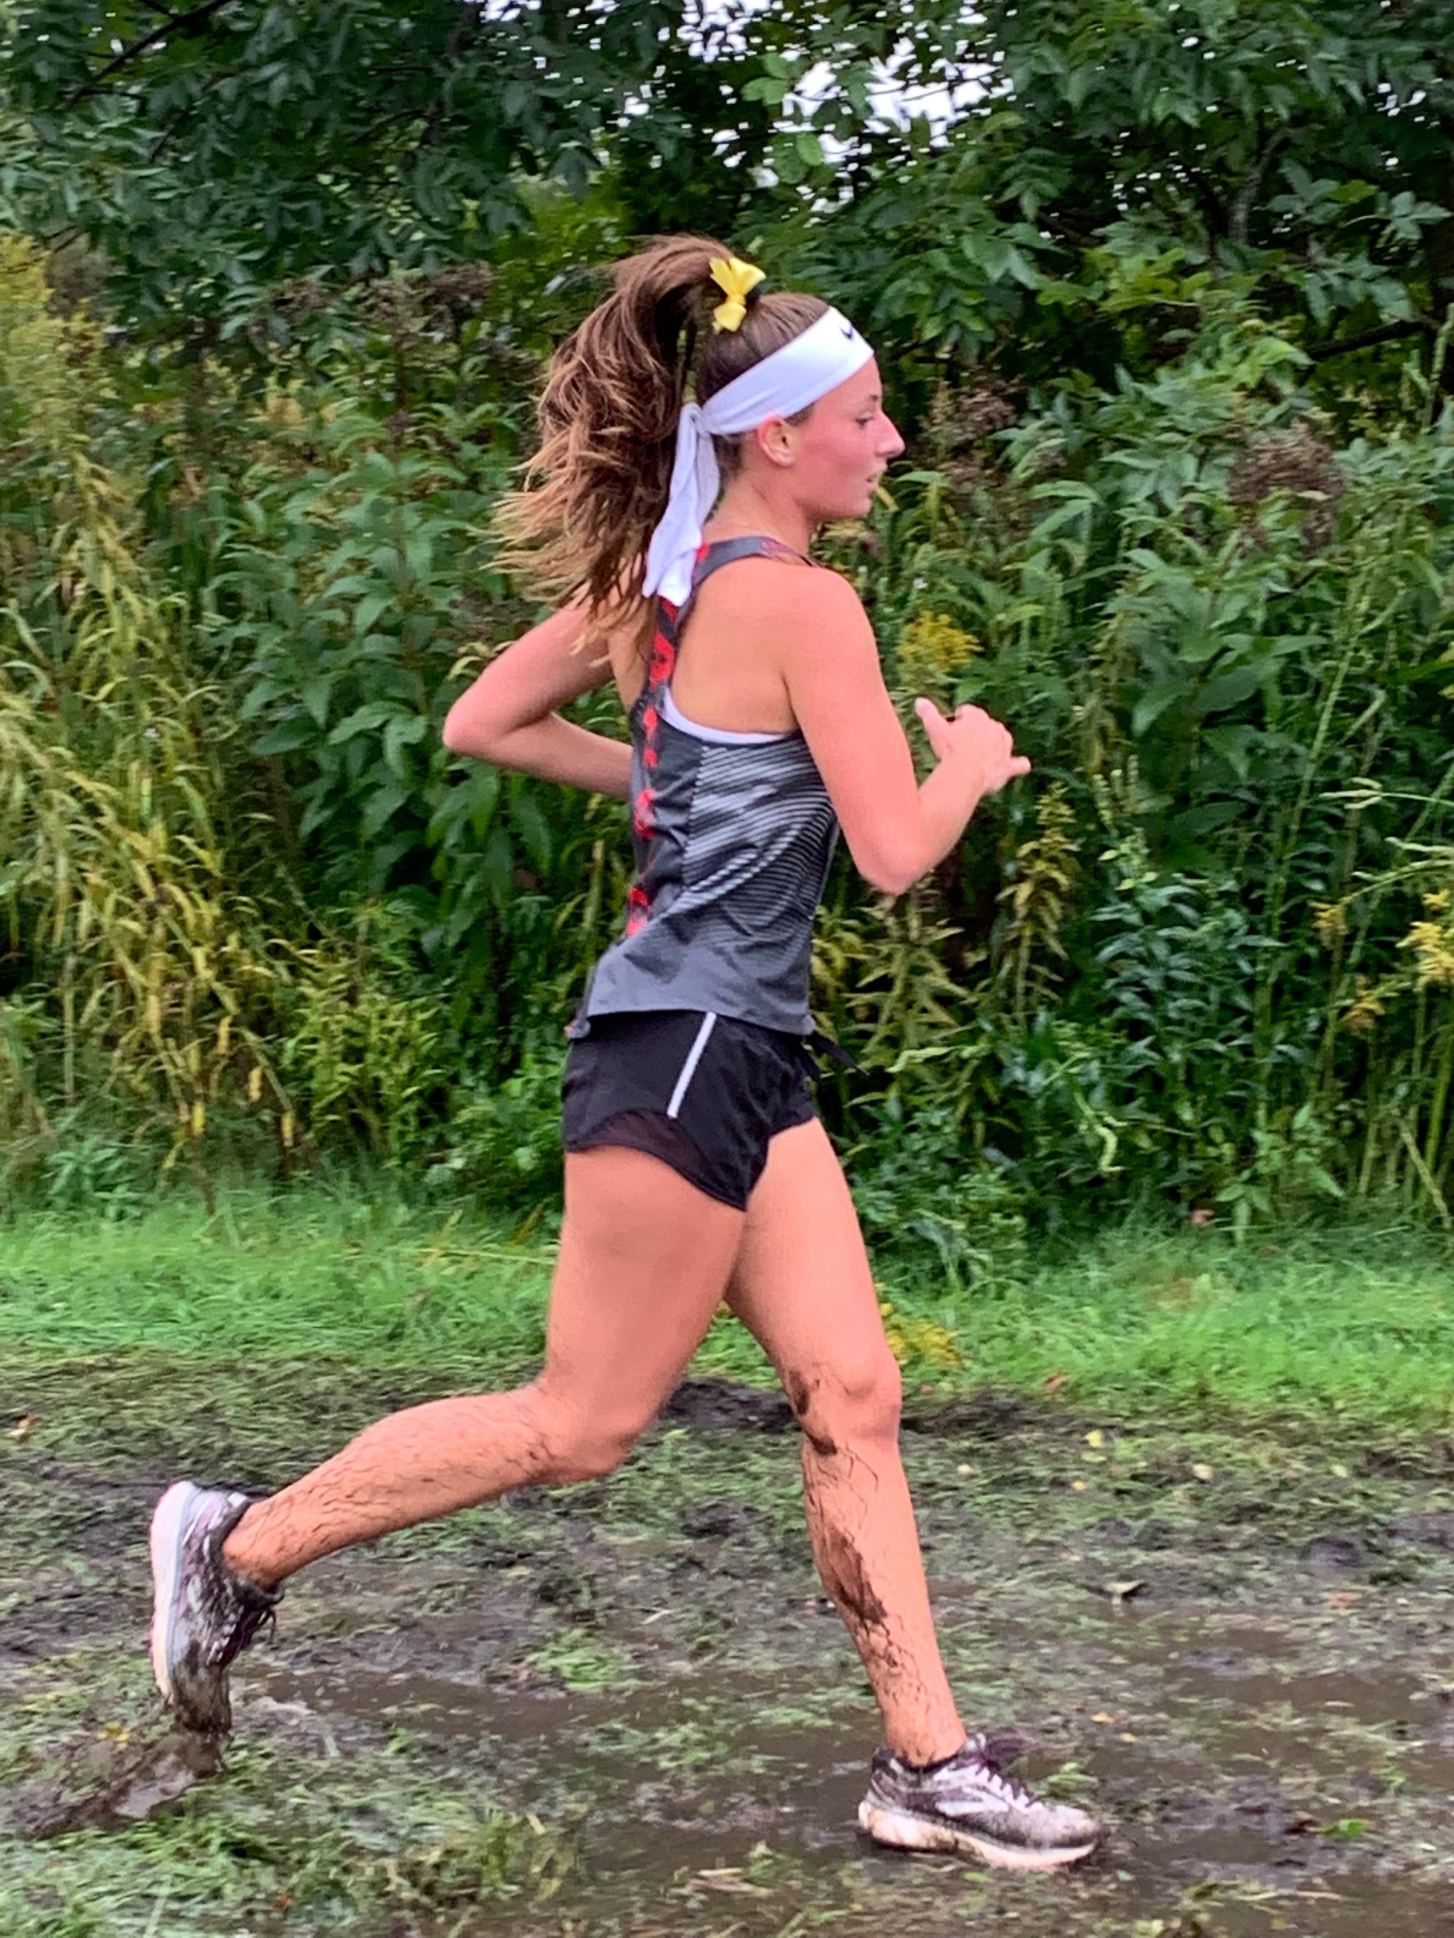
Devin Greenfield
Meet | Date | Dist. | Finish Time | PPM
Home vs. ZB, Warren, Mather | 8/29 | 2 | 18:56 | 9:03
Lake Park Invite | 9/14 | 2mi | 17:25 | 8:42
Main West Quad | 9/17 | 2 | 19:10 | 9:35
Whitney Young Invite | 9/28 | 2mi | 16:20 | 8:10
Niles West Invite | 10/5 | 2mi | 17:21 | 8:41

Slide 39
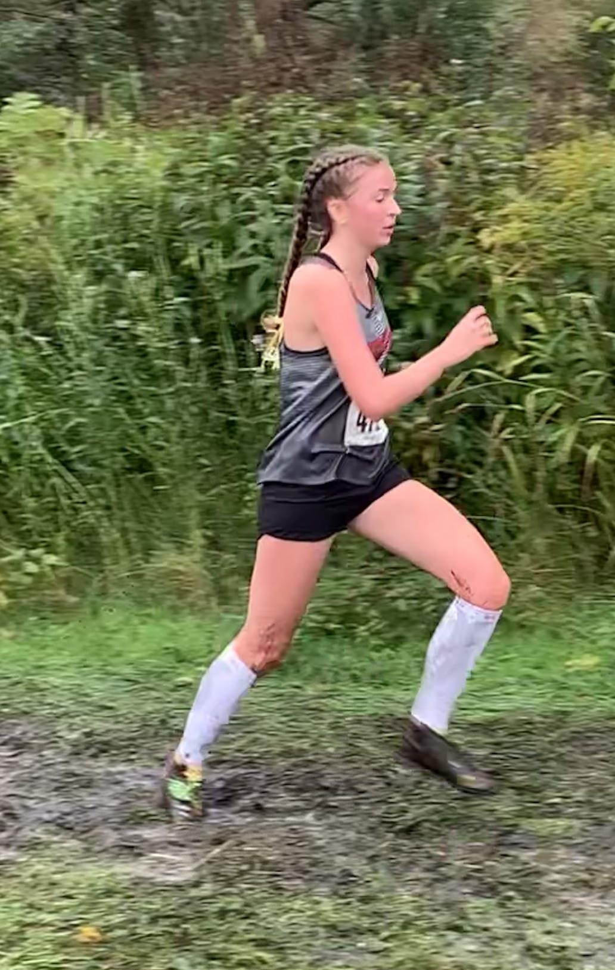
Julia Dowell
Meet | Date | Dist. | Finish Time | PPM
Home vs. ZB, Warren, Mather | 8/29 | 2 | 17:38 | 8:49
Lake Park Invite | 9/14 | 2mi | 16:31 | 8:15
Main West Quad | 9/17 | 3 | 25:59 | 8:40
Peoria/Libertyville | 9/21 | 3 | 28:35 | 9:32
VH Quad | 9/24 | 2mi | 17:24 | 8:32
Whitney Young Invite | 9/28 | 2mi | 16:46 | 8:23
Niles West Invite | 10/5 | 2mi | 17:08 | 8:34

Slide 40
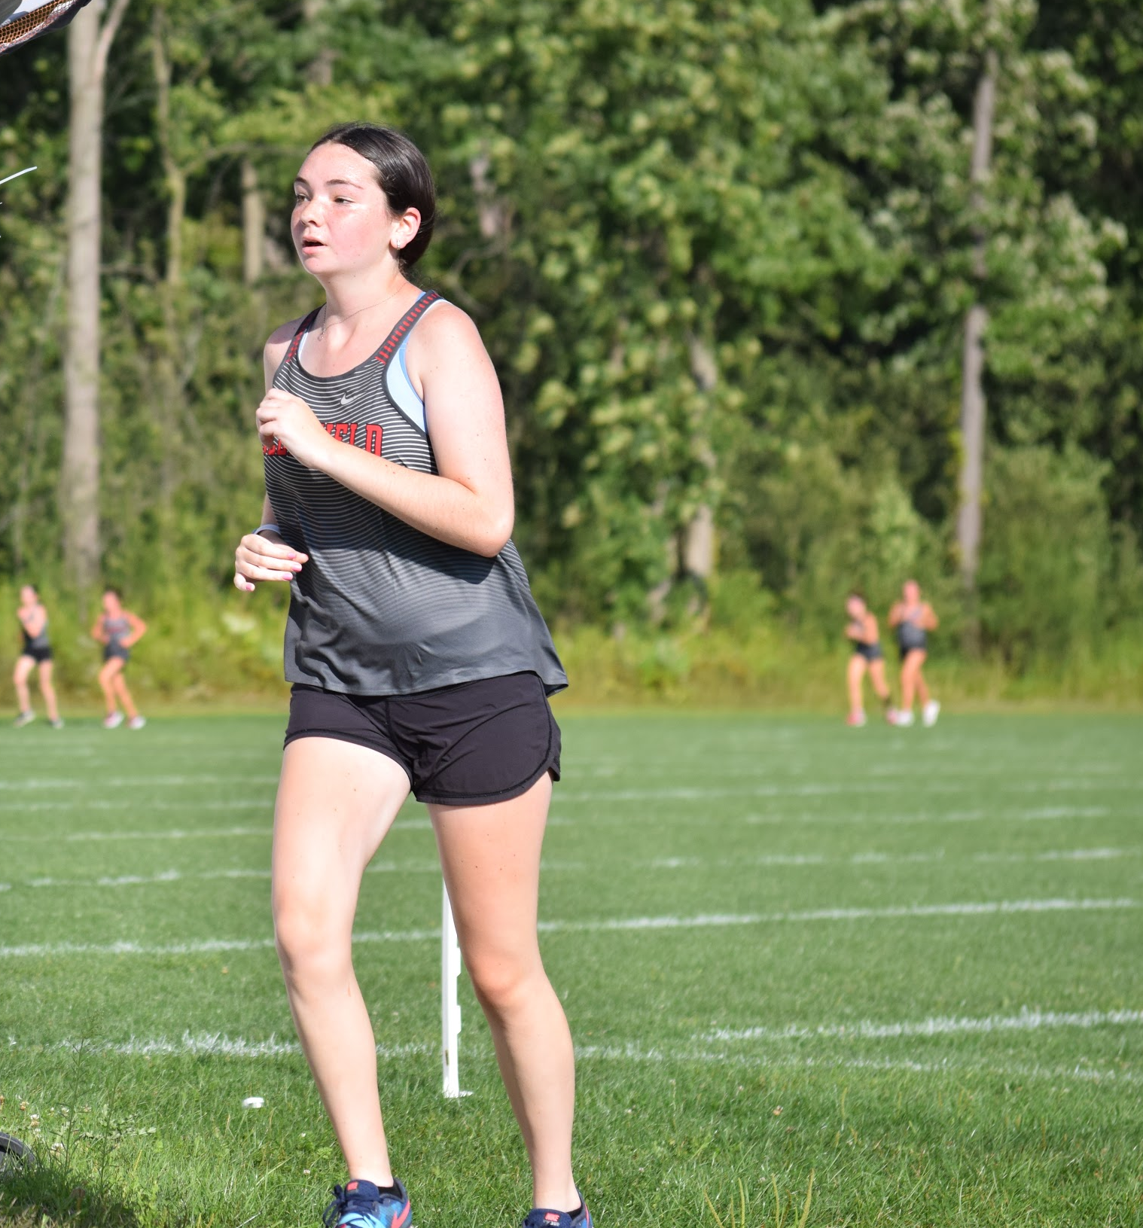
Pam Irgang
Meet | Date | Dist. | Finish Time | PPM
Home vs. ZB, Warren, Mather | 8/29 | 2 | 17:14 | 8:37
Peoria/Libertyville | 9/21 | 3 | 28:3 | 9:21
VH Quad | 9/24 | 2mi | 17:57 | 8:58
Whitney Young Invite | 9/28 | 2mi | 16:43 | 8:21
Niles West Invite | 10/5 | 2mi | 16:46 | 8:23
Conference | 10/20 | 2mi | 15:49 | 7:54

Slide 41
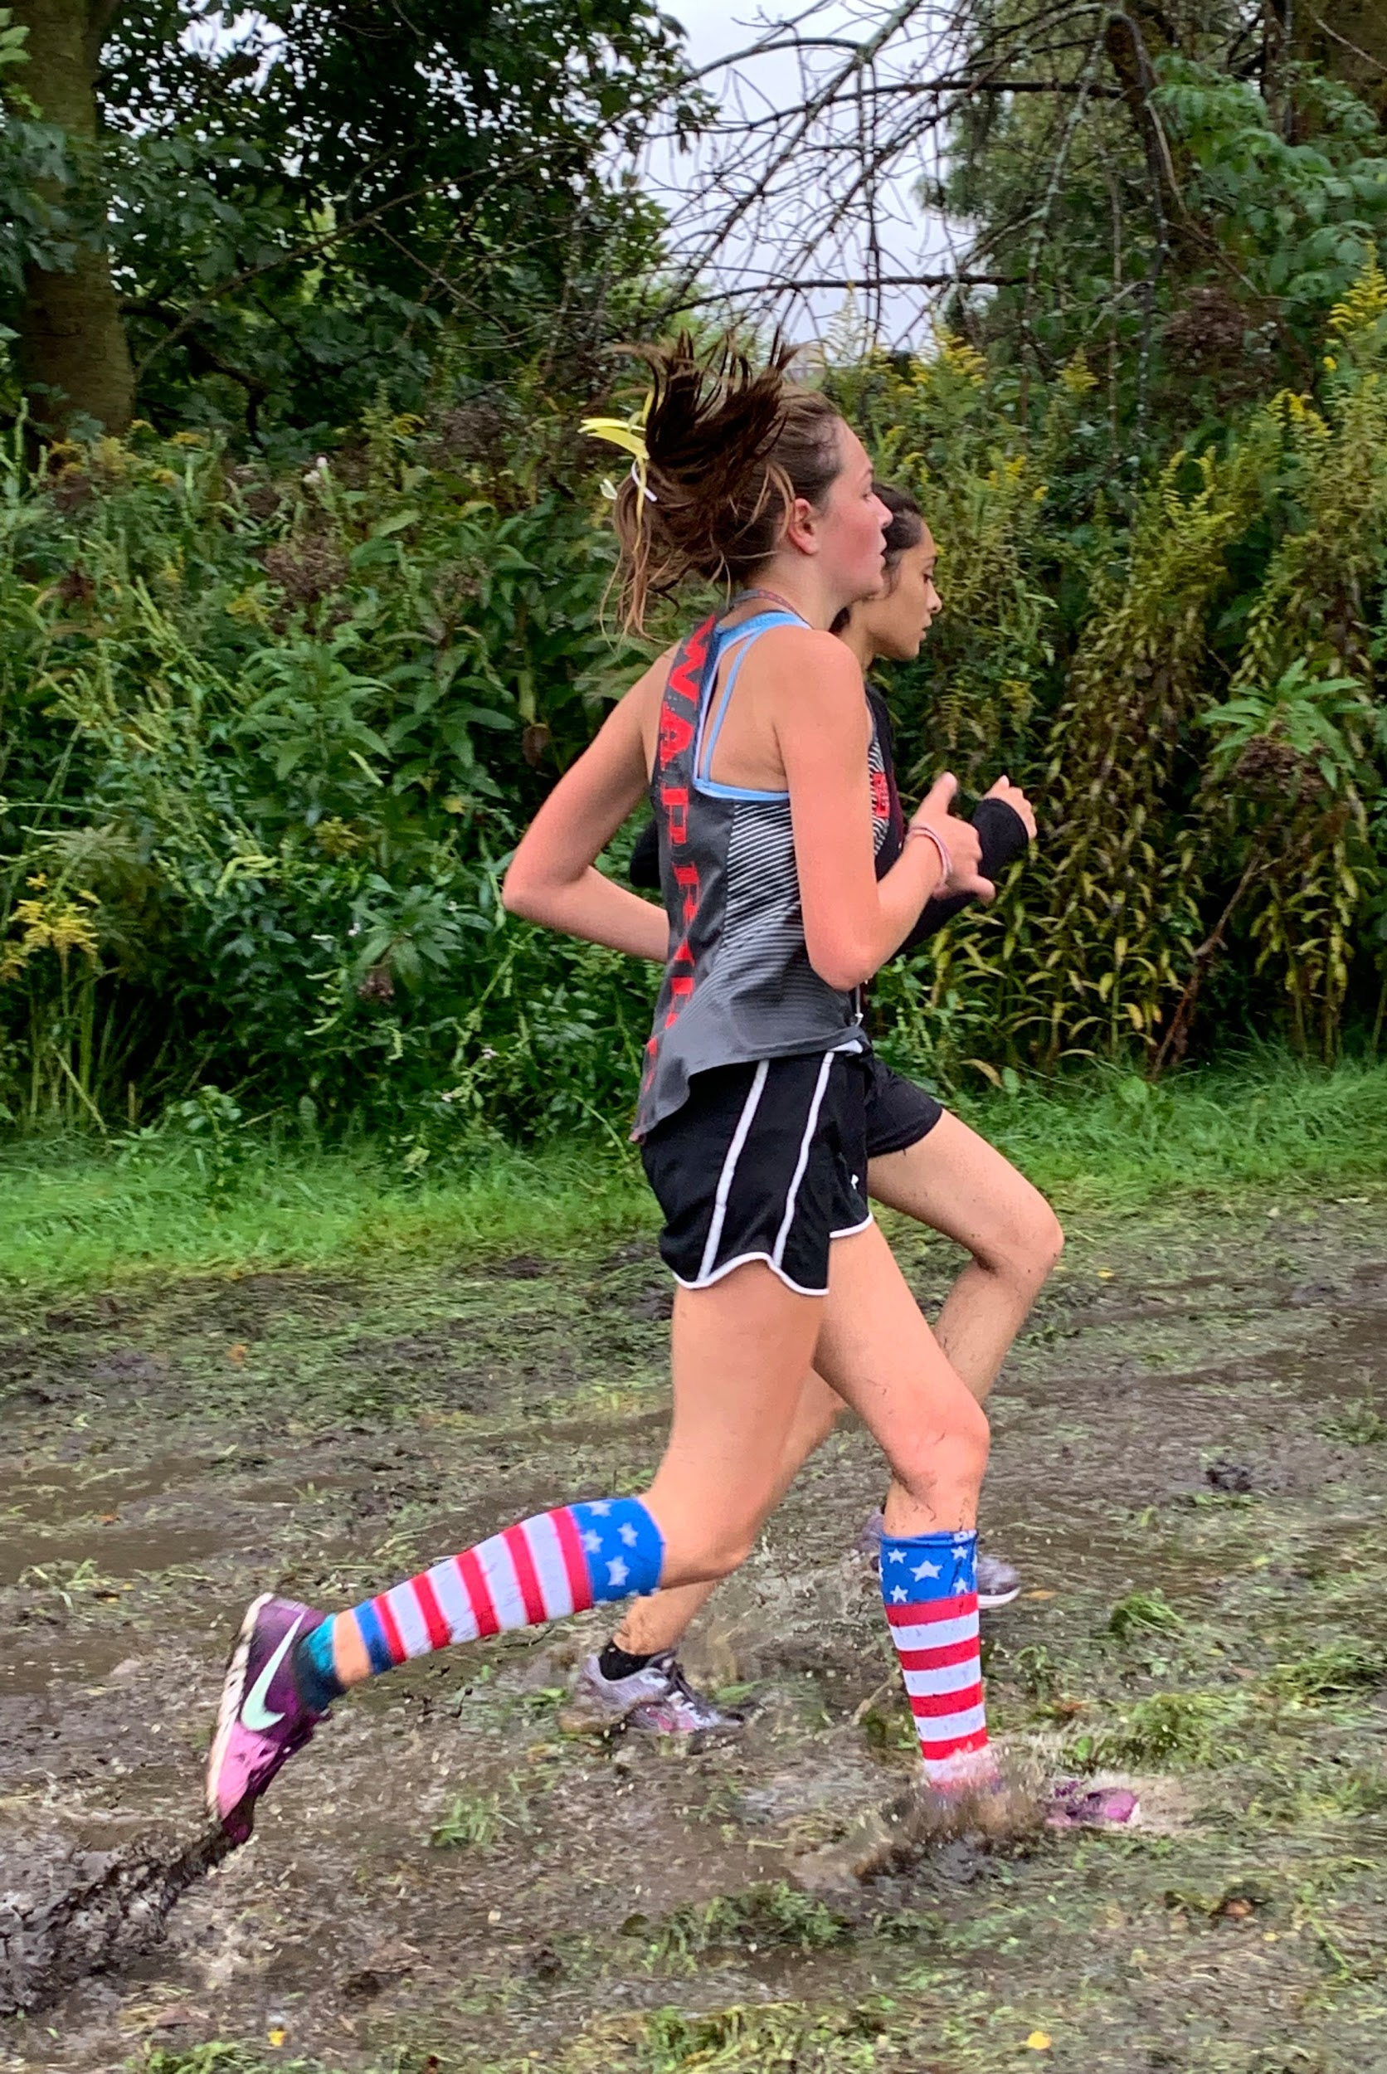
Ella Palzet
Meet | Date | Dist. | Finish Time | PPM
Home vs. ZB, Warren, Mather | 8/29 | 2 | 18:34 | 9:17
Lake Park Invite | 9/14 | 2mi | 17:17 | 8:38
Main West Quad | 9/17 | 2 | 18:59 | 9:30
Peoria/Libertyville | 9/21 | 3 | 29:29 | 9:50
Whitney Young Invite | 9/28 | 2mi | 17:08 | 8:34

Slide 42
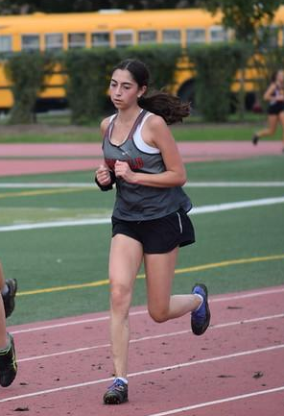
Lexie Cohen
Meet | Date | Dist. | Finish Time | PPM
Home vs. ZB, Warren, Mather | 8/29 | 2 | 18:50 | 9:25
Lake Park Invite | 9/14 | 2mi | 17:39 | 8:49
Main West Quad | 9/17 | 2 | 19:56 | 9:58
Peoria/Libertyville | 9/21 | 3 | 31:43 | 10:34
VH Quad | 9/24 | 2mi | 19:26 | 9:43
Whitney Young Invite | 9/28 | 2mi | 17:44 | 8:52
Niles West Invite | 10/5 | 2mi | 18:21 | 9:10
Conference | 10/20 |  | :

Slide 43
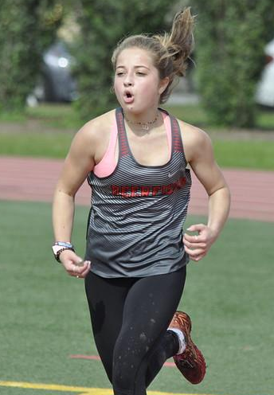
Ellie Greenspon
Meet | Date | Dist. | Finish Time | PPM
Lake Park Invite | 9/14 | 2mi | 15:00 | 7:30
Peoria/Libertyville | 9/21
Niles West Invite | 10/5 | 2mi | 15:50 | 7:52

Slide 44
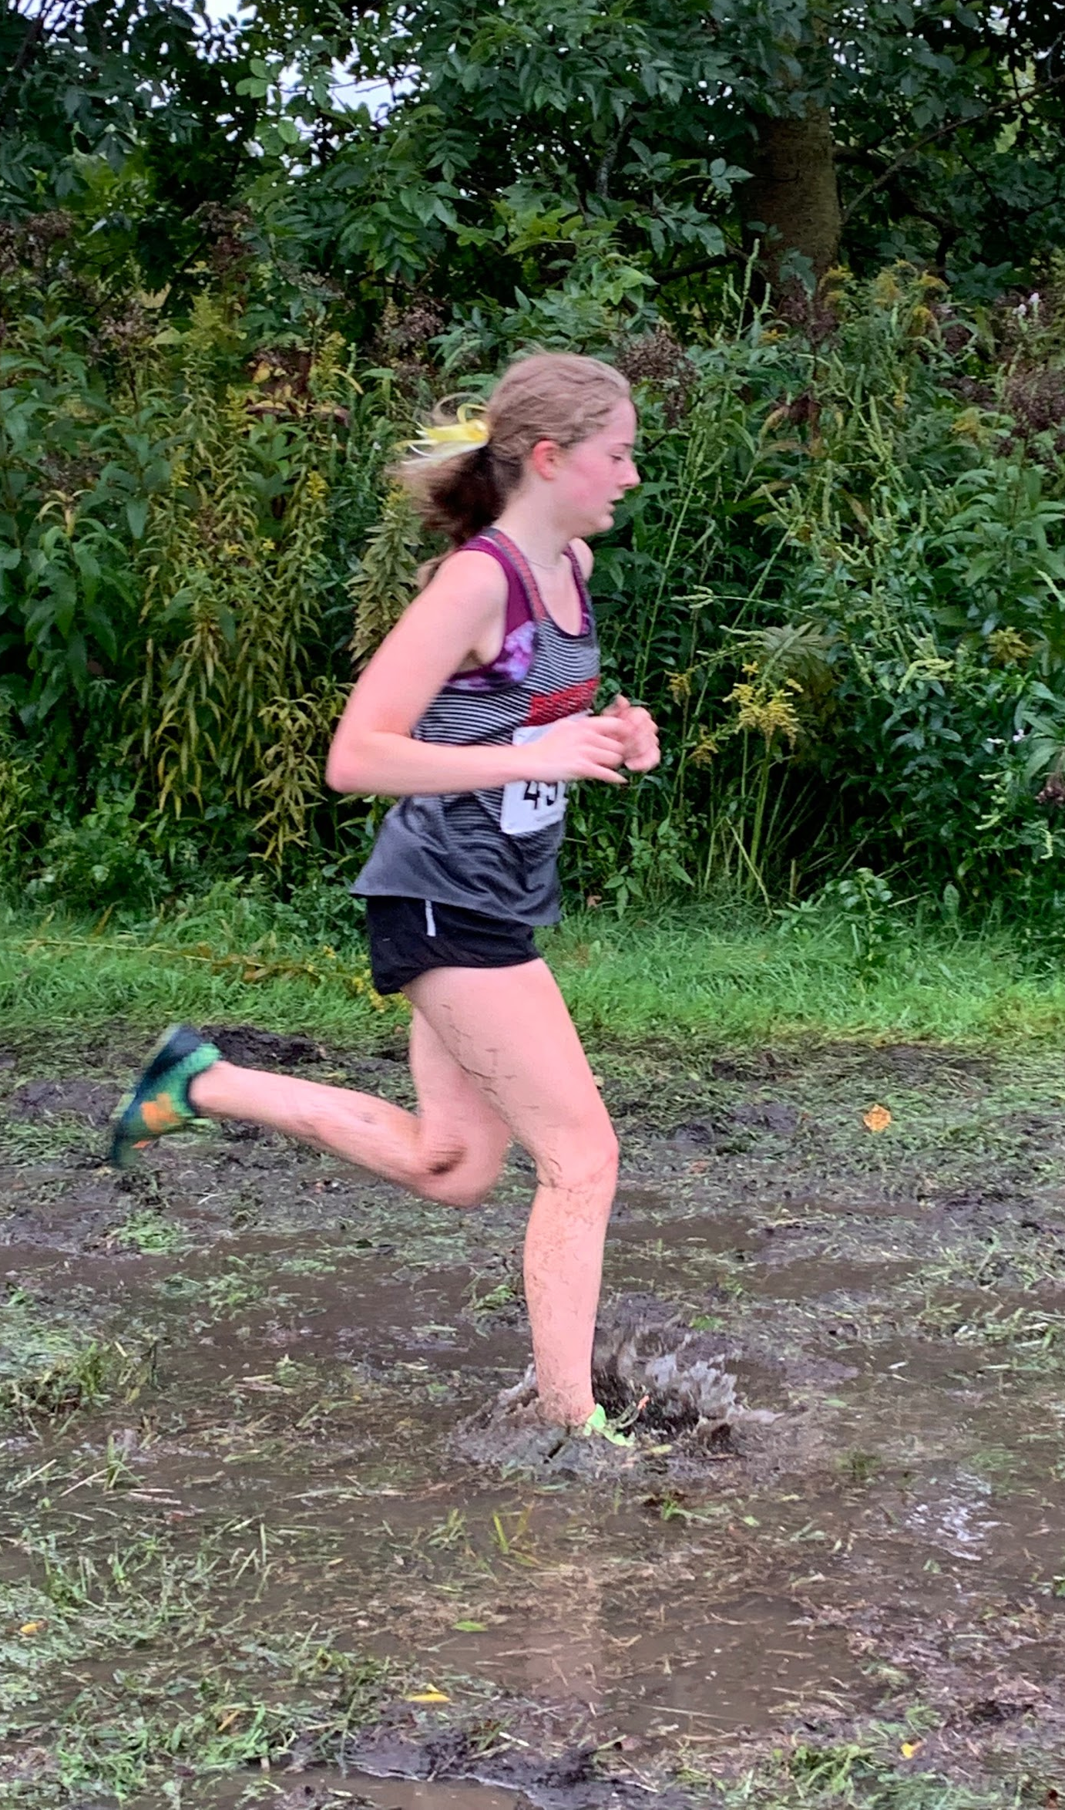
Rebecca Newhall
Meet | Date | Dist. | Finish Time | PPM
Home vs. ZB, Warren, Mather | 8/29 | 2 | 18:29 | 9:15
Lake Park Invite | 9/14 | 2mi | 16:59 | 8:29
Main West Quad | 9/17 | 2 | 18:51 | 9:26
VH Quad | 9/24 | 2mi | 18:16 | 9:08
Whitney Young Invite | 9/28 | 2mi | 16:09 | 8:04
Niles West Invite | 10/5 | 2mi | 17:19 | 8:39
Conference | 10/20 | 2mi | 15:55 | 7:57

Slide 45
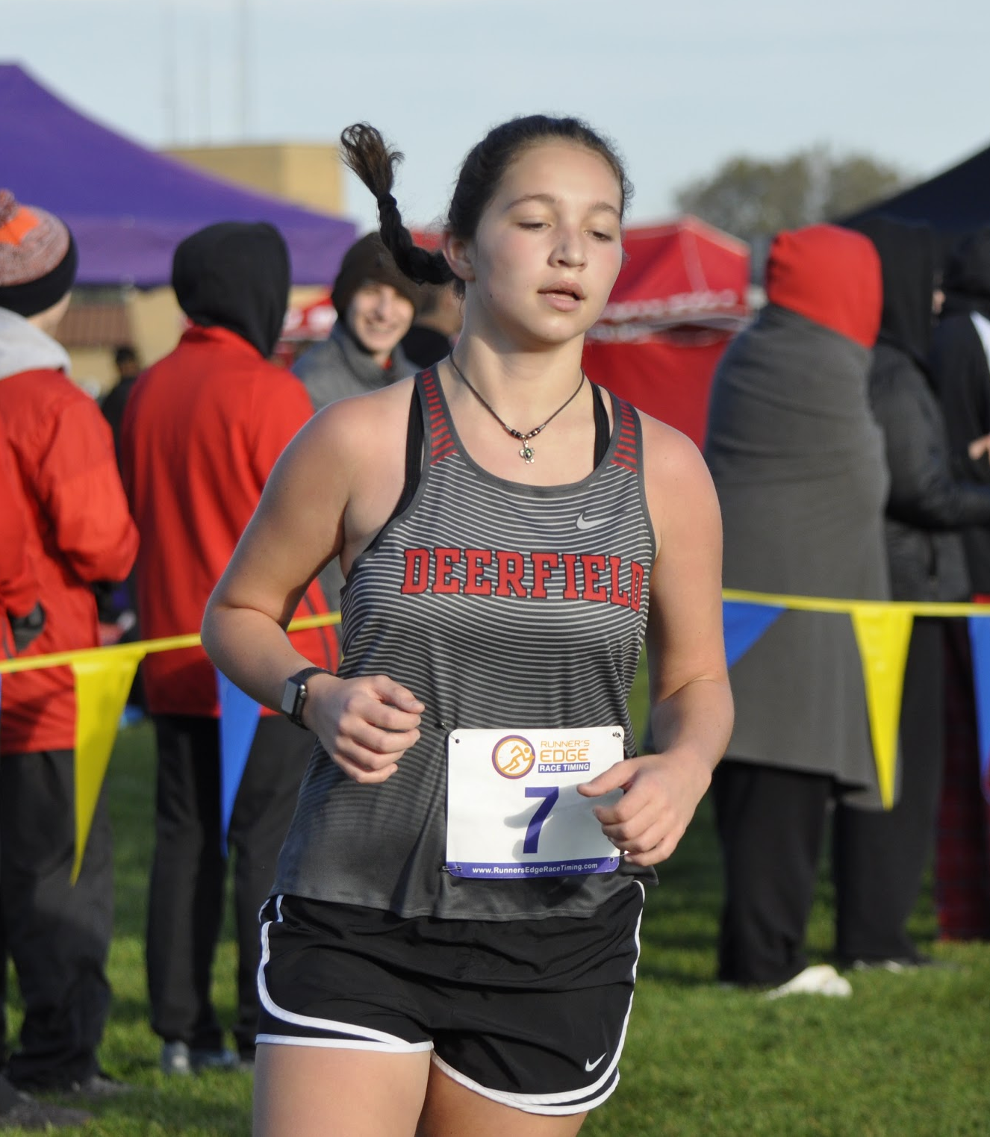
Chelsea Burton
Meet | Date | Dist. | Finish Time | PPM
Home vs. ZB, Warren, Mather | 8/29 | 2 | 18:57 | 9:29
Lake Park Invite | 9/14 | 2mi | 17:37 | 8:48
Main West Quad | 9/17 | 2 | 19:44 | 9:52
Peoria/Libertyville | 9/21 | 3
Whitney Young Invite | 9/28 | 2mi | 17:42 | 8:51
Conference | 10/20 | 2mi | 17:40 | 8:50

Slide 46
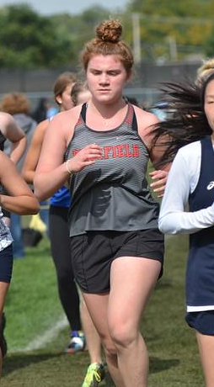
Caroline Vuckovuch
Meet | Date | Dist. | Finish Time | PPM
Niles West Invite | 10/5 | 2mi | 19:07 | 9:33
Conference | 10/20 | 2mi | 19:03 | 9:31

Slide 47
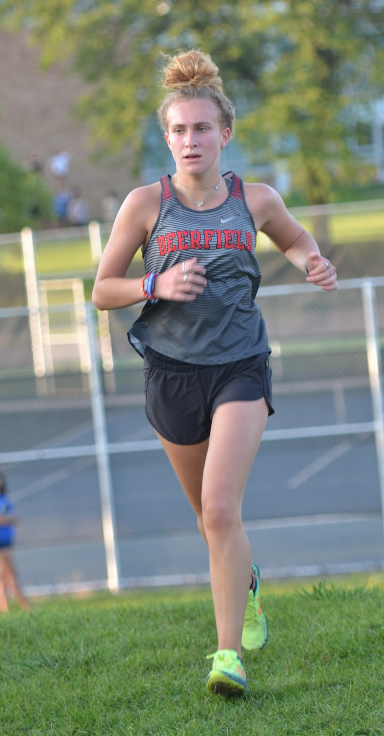
Talia Cohen
Meet | Date | Dist. | Finish Time | PPM
Main West Quad | 9/17 | 3 | 25:29 | 8:30
Peoria/Libertyville | 9/21 | 3 | 28:38 | 9:33
VH Quad | 9/24 | 2mi | 17:20 | 8:40
Niles West Invite | 10/5 | 2mi | 17:48 | 8:54
Conference | 10/20 | 2mi | 16:31 | 8:15

Slide 48
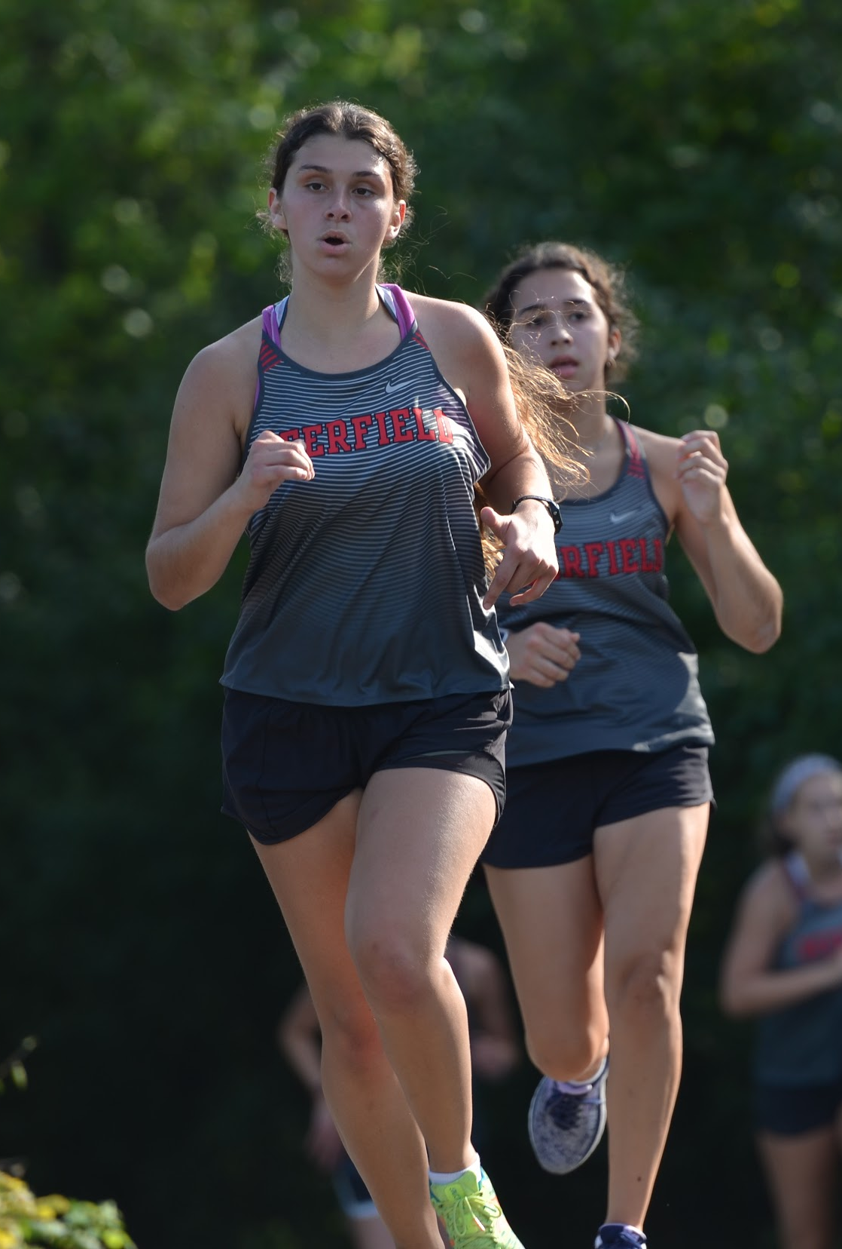
Jordyn Cohen
Meet | Date | Dist. | Finish Time | PPM
Home vs. ZB, Warren, Mather | 8/29 | 2 | 16:08 | 8:04
Lake County | 9/4 | 3.1 | 25:12 | 8:08
Main West Quad | 9/17 | 3 | 25:29 | 8:30
Peoria/Libertyville | 9/21 | 3 | 27:50 | 9:17
VH Quad | 9/24 | 2mi | 16:05 | 8:02
Whitney Young Invite | 9/28 | 2mi | 15:58 | 7:59
Niles West Invite | 10/5 | 3mi | 25:10 | 8:22

Slide 49
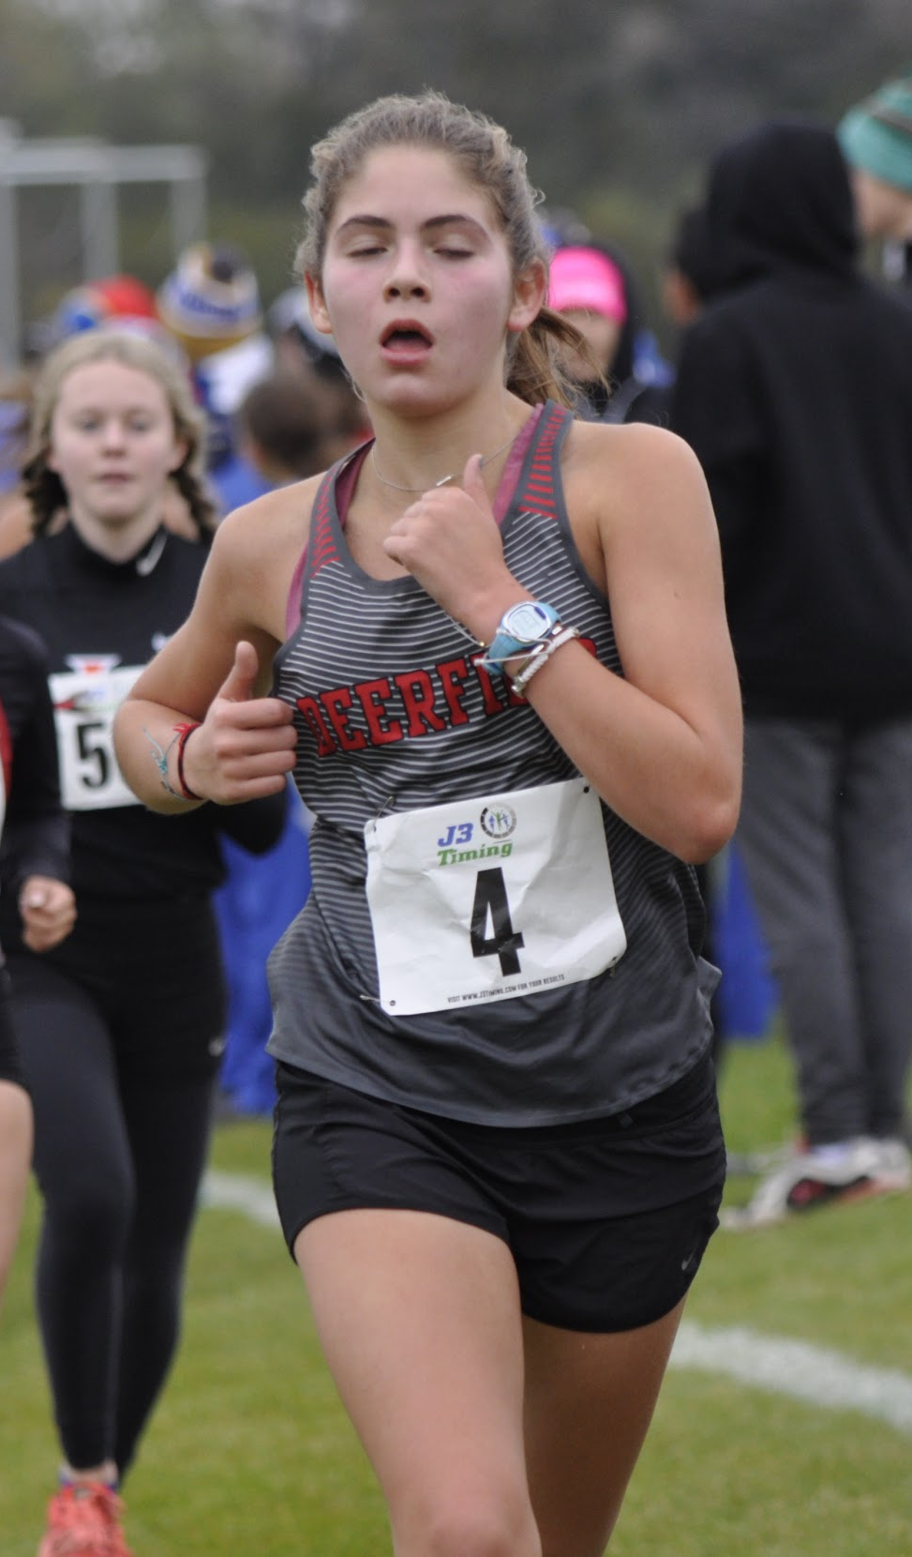
Sofia Martinez
Meet | Date | Dist. | Finish Time | PPM
Home vs. ZB, Warren, Mather | 8/29 | 3 | 21:50 | 7:17
Lake County | 9/4 | 3.1 | 21:47 | 7:16
Lake Park Invite | 9/14 | 3mi | 21:11 | 7:03
Main West Quad | 9/17 | 3 | 22:22 | 7:27
Peoria/Libertyville | 9/21 | 3 | 21:03 | 7:01
VH Quad | 9/24 | 3mi | 23:12 | 7:43
Whitney Young Invite | 9/28 | 3mi | 21:27 | 7:09
Niles West Invite | 10/5 | 3mi | 21:34 | 7:11
Conference | 10/20 | 3mi | 21:02 | 7:00
Regional | 10/26 | 3 | 20:02 | 6:41

Slide 50

Avery Martin
Meet | Date | Dist. | Finish Time | PPM
Home vs. ZB, Warren, Mather | 8/29 | 3 | 23:21 | 7:47
Lake County | 9/4 | 3.1 | 23:34 | 7:36
Lake Park Invite | 9/14 | 3mi | 24:04 | 8:01
Main West Quad | 9/17 | 3 | 24:21 | 8:07
Peoria/Libertyville | 9/21 | 3 | 25:50 | 8:37
VH Quad | 9/24 | 2mi | 15:58 | 7:59
Whitney Young Invite | 9/28 | 2mi | 16:02 | 8:01

Slide 51

Nicole Dobrin
Meet | Date | Dist. | Finish Time | PPM
Lake County | 9/4 | 3.1 | 22:16 | 7:11
Main West Quad | 9/17 | 3 | 22:18 | 7:26
Peoria/Libertyville | 9/21
VH Quad | 9/24 | 3mi | 23:20 | 7:46
Whitney Young Invite | 9/28 | 3mi | 22:13 | 7:24
Niles West Invite | 10/5 | 3mi | 22:07 | 7:22
Conference | 10/20 | 3mi | 20:55 | 6:57
Regional | 10/26 | 3 | 19:56 | 6:39

Slide 52


SENIORS

Slide 53

Jackie Trachtenberg

Slide 54

Iza Guzek

Slide 55

Orli Sheffey
Meet | Date | Dist. | Finish Time | PPM
Home vs. ZB, Warren, Mather | 8/29 | 2 | 20:08 | 10:04
Peoria/Libertyville | 9/21 | 3 | 32:05 | 10:42
VH Quad | 9/24 | 2mi | 21:25 | 10:42
Whitney Young Invite | 9/28 | 2mi | 19:50 | 9:55
Niles West Invite | 10/5 | 2mi | 20:36 | 10:18
Conference | 10/20 | 2mi | 19:41 | 9:50

Slide 56

Hailey Abramovitch
Meet | Date | Dist. | Finish Time | PPM
Home vs. ZB, Warren, Mather | 8/29 | 2 | 16:00 | 8:00

Slide 57

Maya Geren
Meet | Date | Dist. | Finish Time | PPM
Home vs. ZB, Warren, Mather | 8/29 | 2 | 16:58 | 8:29
Main West Quad | 9/17 | 3 | 25:57 | 8:39
Peoria/Libertyville | 9/21 | 3 | 28:43 | 9:34
VH Quad | 9/24 | 2mi | 16:37 | 8:18
Niles West Invite | 10/5 | 2mi | 16:43 | 9:21
Conference | 10/20 | 2mi | 15:40 | 7:40

Slide 58

Alex Tiatia
Meet | Date | Dist. | Finish Time | PPM
Home vs. ZB, Warren, Mather | 8/29 | 2 | 14:55 | 7:28
Lake County | 9/4 | 3.1 | 23:25 | 7:33
Lake Park Invite | 9/14 | 3mi | 22:26
Main West Quad | 9/17 | 3 | 22:42 | 7:34
Peoria/Libertyville | 9/21 | 3 | 21:34 | 7:11
VH Quad | 9/24 | 3mi | 22:53 | 7:37
Whitney Young Invite | 9/28 | 3mi | 22:16 | 7:25
Niles West Invite | 10/5 | 3mi | 22:13 | 7:24
Conference | 10/20 | 3mi | 21:30 | 7:10

Slide 59

Alexis Lirtzman
Meet | Date | Dist. | Finish Time | PPM
Home vs. ZB, Warren, Mather | 8/29 | 2 | 19:27 | 9:44
Main West Quad | 9/17 | 2 | 22:03 | 11:02
Whitney Young Invite | 9/28 | 2mi | 19:16 | 9:38
Niles West Invite | 10/5 | 2mi | 19:11 | 9:35
Conference | 10/20 | 2mi | 18:50 | 9:25

Slide 60

Carly Fisher
Meet | Date | Dist. | Finish Time | PPM
Home vs. ZB, Warren, Mather | 8/29 | 2 | 19:26 | 9:43
Main West Quad | 9/17 | 2 | 21:48 | 10:54
VH Quad | 9/24 | 2mi | 19:38 | 9:49
Whitney Young Invite | 9/28 | 2mi | 18:47 | 9:23
Conference | 10/20 | 2mi | 17:52 | 8:51

Slide 61

Brooke DeMaio
Meet | Date | Dist. | Finish Time | PPM
Home vs. ZB, Warren, Mather | 8/29 | 3 | 25:37 | 8:32
Lake County | 9/4 | 3.1 | 24:09 | 7:47
Lake Park Invite | 9/14 | 3mi | 25:04 | 8:21
Main West Quad | 9/17 | 3 | 25:43 | 8:34
Peoria/Libertyville | 9/21 | 3 | 27:52 | 9:17
VH Quad | 9/24 | 2mi | 17:25 | 8:42
Whitney Young Invite | 9/28 | 2mi | 17:18 | 8:39
Niles West Invite | 10/5 | 2mi | 17:33 | 8:45
Conference | 10/20 | 2mi | 16:27 | 8:13

Slide 62

Shaylee Roth
Meet | Date | Dist. | Finish Time | PPM
Lake County | 9/4 | 3.1 | 21:17 | 6:52
Lake Park Invite | 9/14 | 3mi | 20:07
Main West Quad | 9/17 | 3 | 23:19 | 7:46
Peoria/Libertyville | 9/21 | 3 | 25:43 | 8:34
VH Quad | 9/24 | 3mi | 22:48 | 7:35
Whitney Young Invite | 9/28 | 3mi | 21:12 | 7:04
Niles West Invite | 10/5 | 3mi | 23:07 | 7:41
Conference | 10/20 | 3mi | 20:13 | 6:43
Regional | 10/26 | 3 | 19:09 | 6:23

Slide 63

Deirdre Shore
Meet | Date | Dist. | Finish Time | PPM
Home vs. ZB, Warren, Mather | 8/29 | 2 | 17:09 | 8:35
Lake Park Invite | 9/14 | 2mi | 15:42 | 7:51
Main West Quad | 9/17 | 3 | 25:35 | 8:32
Peoria/Libertyville | 9/21 | 3 | 26:44 | 8:55
VH Quad | 9/24 | 2mi | 16:33 | 8:16
Niles West Invite | 10/5 | 2mi | 18:28 | 9:14
Conference | 10/20 | 2mi | 15:58 | 7:59

Slide 64

Jillian Getter
Meet | Date | Dist. | Finish Time | PPM
Lake County | 9/4 | 3.1 | 22:11 | 7:09
Peoria/Libertyville | 9/21 | 3 | 22:52 | 7:37
VH Quad | 9/24 | 3mi | 22:47 | 7:35
Whitney Young Invite | 9/28 | 3mi | 24:35 | 8:12
Conference | 10/20 | 3mi | 21:08 | 7:03

Slide 65

Marni Schneider
Meet | Date | Dist. | Finish Time | PPM
Home vs. ZB, Warren, Mather | 8/29 | 2 | 15:38 | 7:49
Lake County | 9/4 | 3.1 | 25:18 | 8:10
Main West Quad | 9/17 | 3 | 25:08 | 8:23
Peoria/Libertyville | 9/21 | 3 | 25:55 | 8:38
VH Quad | 9/24 | 2mi | 16:01 | 8:00
Whitney Young Invite | 9/28 | 2mi | 16:15 | 8:07
Conference | 10/20 | 2mi | 15:14 | 7:37

Slide 66

Liza Bluman
Meet | Date | Dist. | Finish Time | PPM
Home vs. ZB, Warren, Mather | 8/29 | 2 | 15:14 | 7:37
Lake County | 9/4 | 3.1 | 25:12 | 8:08
Main West Quad | 9/17 | 3 | 24:55 | 8:18
Peoria/Libertyville | 9/21 | 3 | 26:43 | 8:54
VH Quad | 9/24 | 2mi | 15:26 | 7:43
Whitney Young Invite | 9/28 | 2mi | 15:31 | 7:45
Conference | 10/20 | 2mi | 14:59 | 7:29

Slide 67

Charlotte Larson
Meet | Date | Dist. | Finish Time | PPM
Home vs. ZB, Warren, Mather | 8/29 | 2 | 17:7 | 8:34
Lake Park Invite | 9/14 | 2mi | 16:51 | 8:25
Main West Quad | 9/17 | 3 | 27:24 | 9:08
Peoria/Libertyville | 9/21 | 3 | 28:46 | 9:35
VH Quad | 9/24 | 2mi | 18:49 | 9:24
Whitney Young Invite | 9/28 | 2mi | 16:55 | 8:27
Conference | 10/20 | 2mi | 16:10 | 8:05

Slide 68

Kayla
Kriegel
Meet | Date | Dist. | Finish Time | PPM
Home vs. ZB, Warren, Mather | 8/29 | 2 | 17:02 | 8:31
Lake Park Invite | 9/14 | 2mi | 16:06 | 8:03
Main West Quad | 9/17 | 3 | 26:12 | 8:44
Peoria/Libertyville | 9/21 | 3 | 27:24 | 9:08
VH Quad | 9/24 | 2mi | 16:56 | 8:28
Whitney Young Invite | 9/28 | 2mi | 16:14 | 8:07
Niles West Invite | 10/5 | 2mi | 16:50 | 8:25
Conference | 10/20 | 2mi | 15:45 | 7:52

Slide 69

Megan Bergin
Meet | Date | Dist. | Finish Time | PPM
Home vs. ZB, Warren, Mather | 8/29 | 2 | 17:58 | 8:59
Lake Park Invite | 9/14 | 2mi | 16:41 | 8:20
Main West Quad | 9/17 | 3 | 27:29 | 9:10
Peoria/Libertyville | 9/21 | 3 | 29:03 | 9:41
VH Quad | 9/24 | 2mi | 17:58 | 8:59
Niles West Invite | 10/5 | 2mi | 17:43 | 8:51
Conference | 10/20 | 2mi | 16:24 | 8:12

Slide 70

Maeve Butler
Meet | Date | Dist. | Finish Time | PPM
Home vs. ZB, Warren, Mather | 8/29 | 2 | 19:23 | 9:42
Lake Park Invite | 9/14 | 2mi | 18:00 | 9:00
Main West Quad | 9/17 | 2 | 20:19 | 10:10
Peoria/Libertyville | 9/21 | 3 | 29:14 | 9:45
Whitney Young Invite | 9/28 | 2mi | 17:49 | 8:54
Niles West Invite | 10/5 | 2mi | 18:36 | 9:18
Conference | 10/20 | 2mi | 16:54 | 8:27

Slide 71

Scarlette Wolk
Meet | Date | Dist. | Finish Time | PPM
Home vs. ZB, Warren, Mather | 8/29 | 3 | 23:00 | 7:05
Lake County | 9/4 | 3.1 | 22:19 | 7:12
Lake Park Invite | 9/14 | 3mi | 21:55 | 7:18
Main West Quad | 9/17 | 3 | 22:27 | 7:29
Peoria/Libertyville | 9/21 | 3 | 21:52 | 7:17
VH Quad | 9/24 | 3mi | 23:27 | 7:49
Whitney Young Invite | 9/28 | 3mi | 22:53 | 7:37
Niles West Invite | 10/5 | 3mi | 22:39 | 7:33
Conference | 10/20 | 3mi | 21:24 | 7:08

Slide 72

Emily Slutzky
Meet | Date | Dist. | Finish Time | PPM
Lake County | 9/4 | 3.1 | 24:01 | 7:45
Lake Park Invite | 9/14 | 3mi | 22:11 | 7:23
Main West Quad | 9/17 | 3 | 22:36 | 7:32
Peoria/Libertyville | 9/21 | 3 | 21:59 | 7:20
Whitney Young Invite | 9/28 | 3mi | 22:43 | 7:34
Niles West Invite | 10/5 | 3mi | 22:18 | 7:26
Conference | 10/20 | 3mi | 22:59 | 7:39

Slide 73

Thanks for a great season!
Coach Beaumont

Slide 74

Thanks for a great season!
Coach Ellen

Slide 75

Thanks for a great season!
Coach Monica

